Slide 1
Financial Stability 2017/1
Charts
April 2017

Slide 2
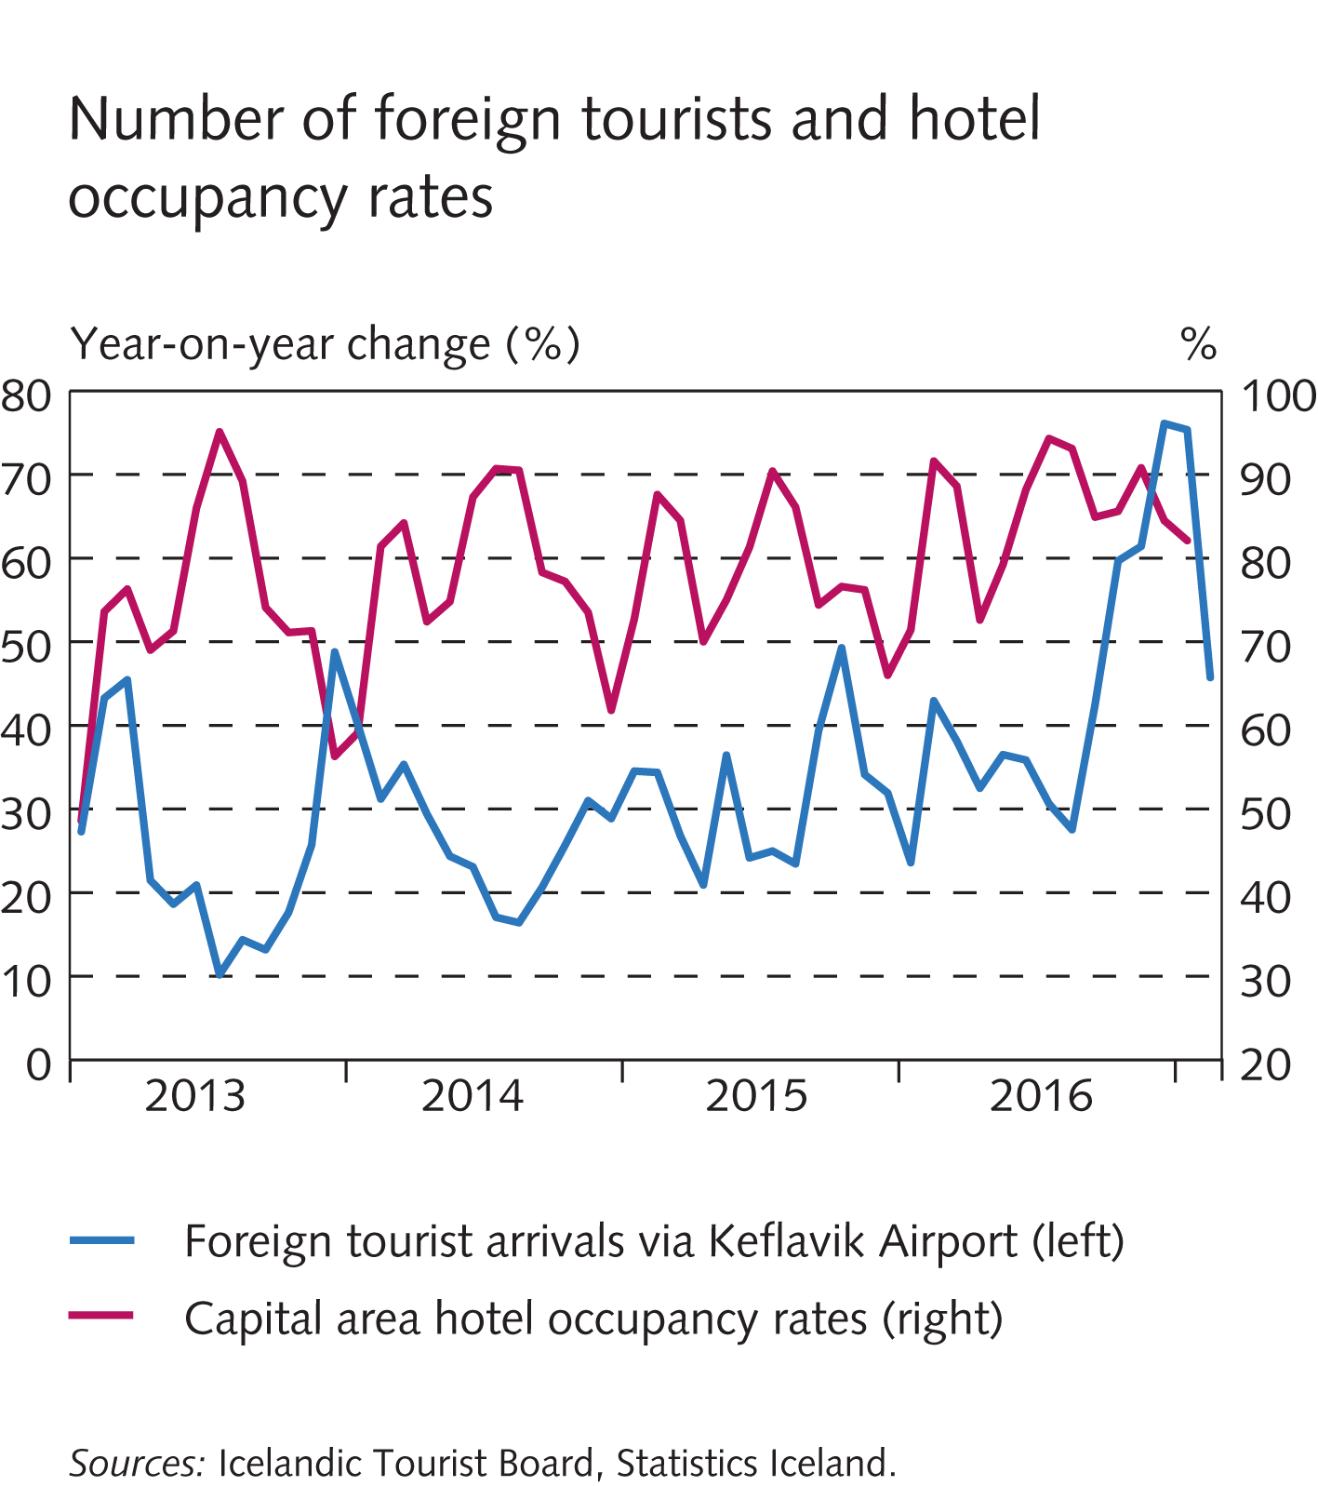
Key risks

Slide 3
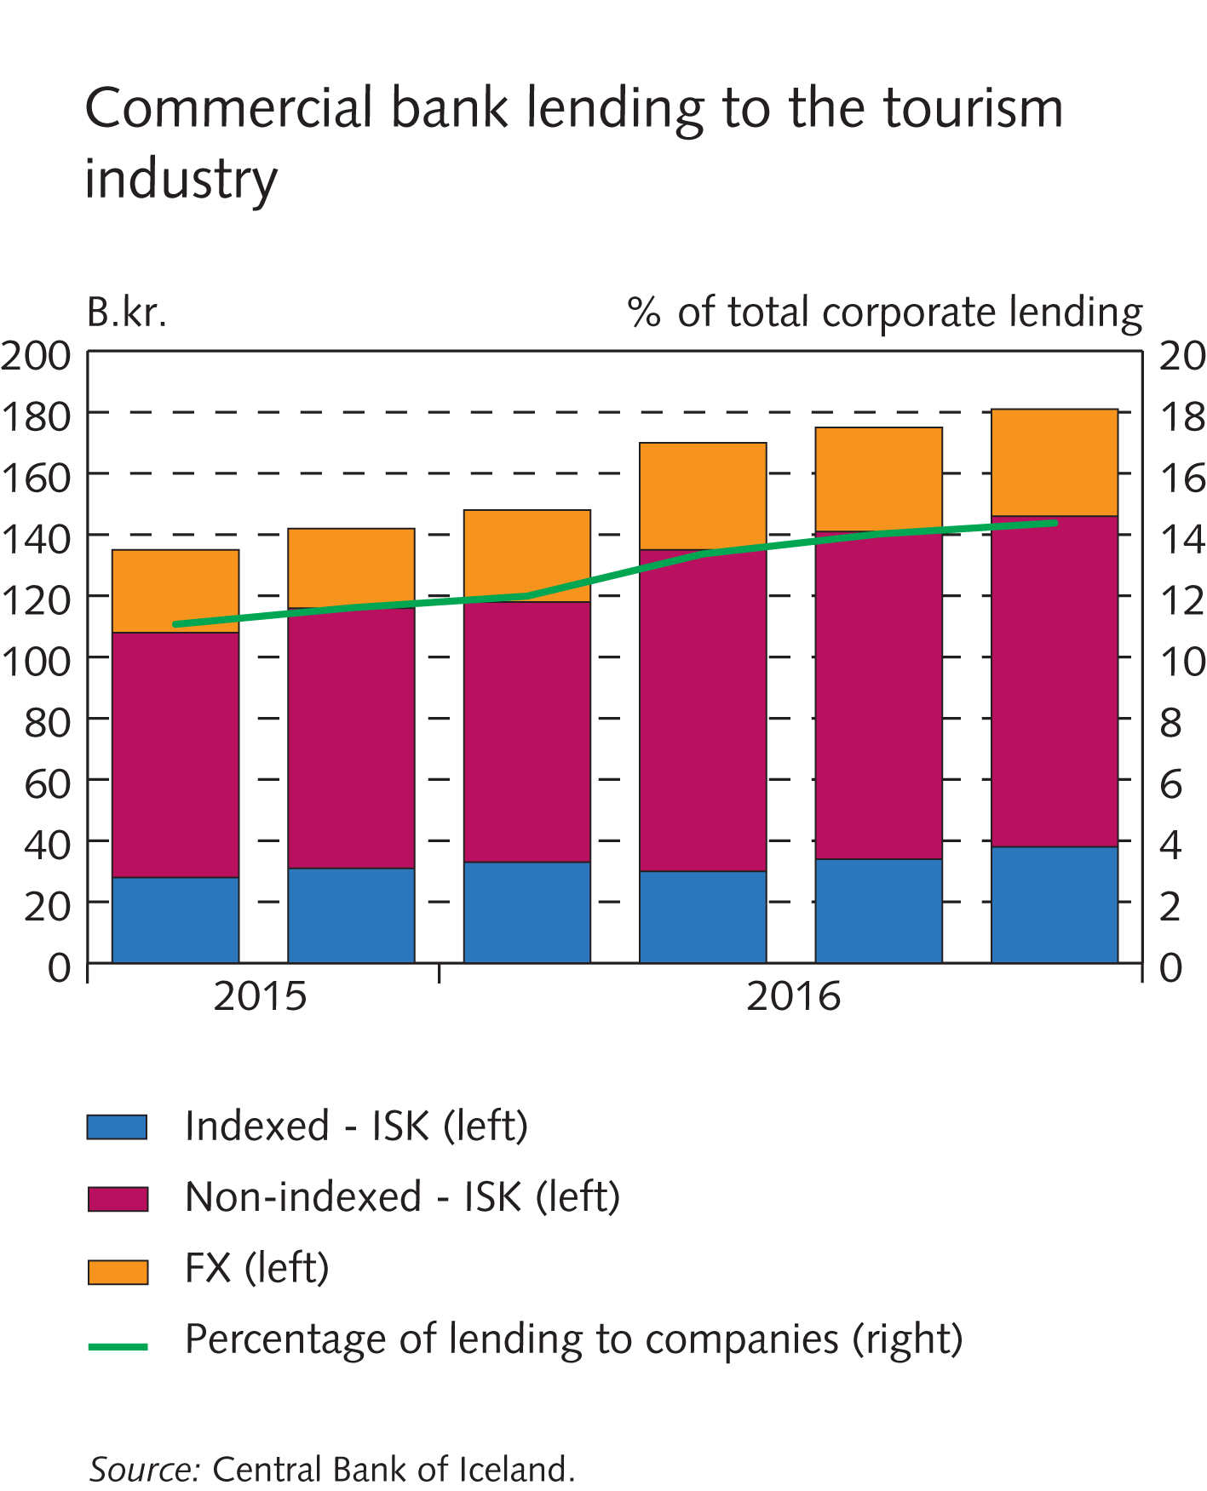
Key risks

Slide 4
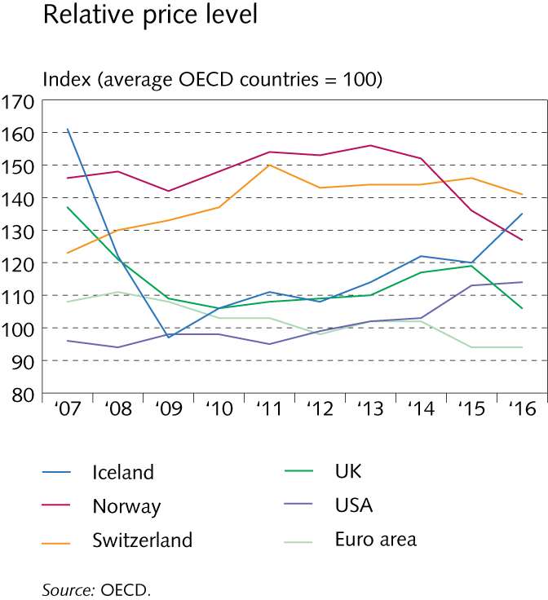
Key risks

Slide 5
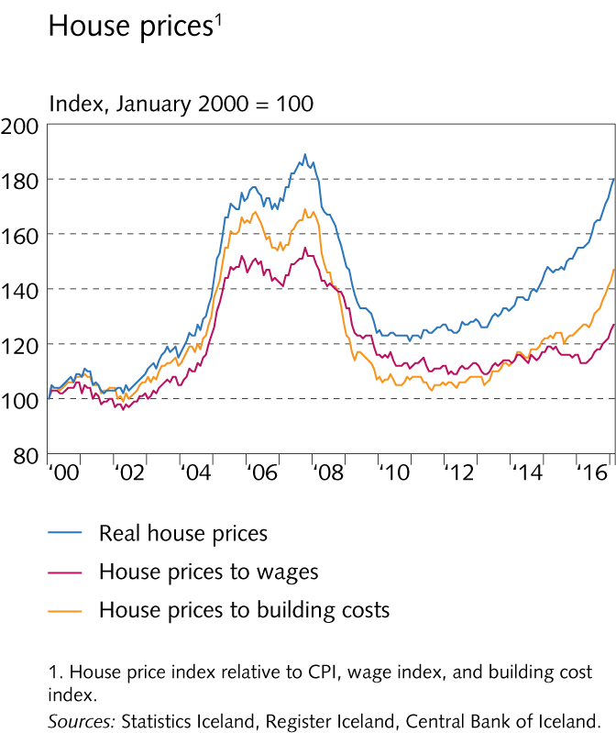
Key risks

Slide 6
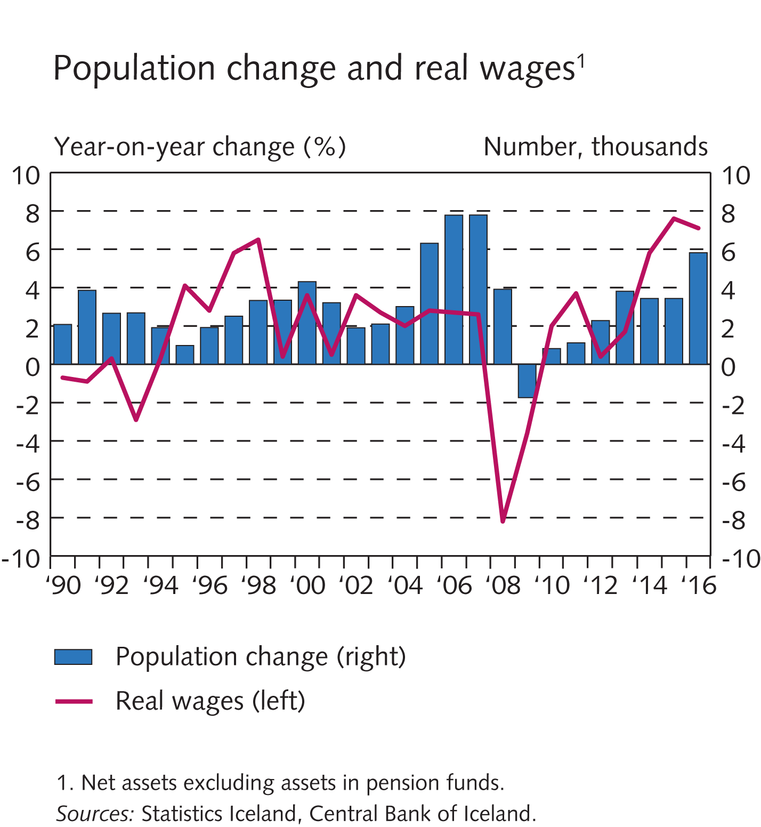
Key risks

Slide 7
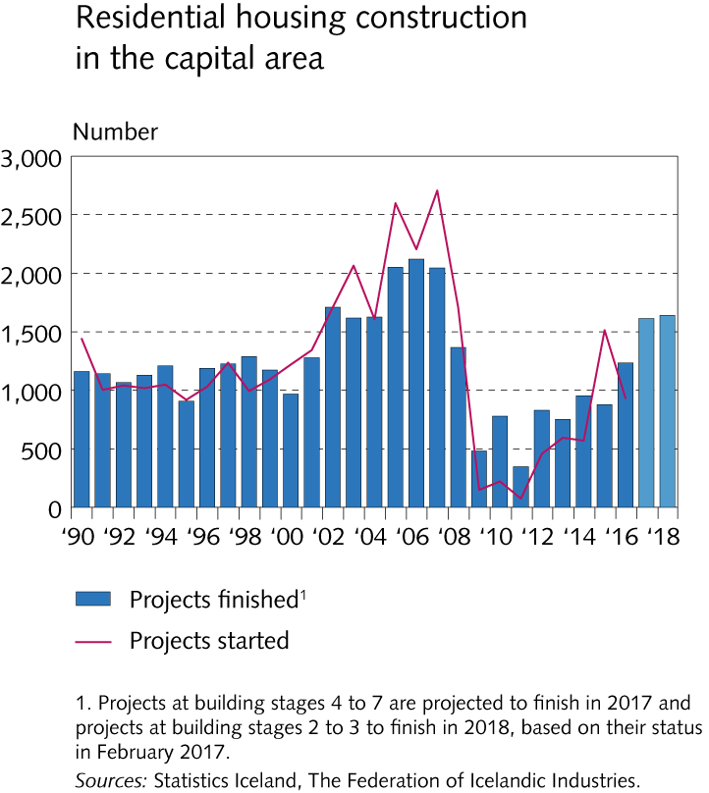
Key risks

Slide 8
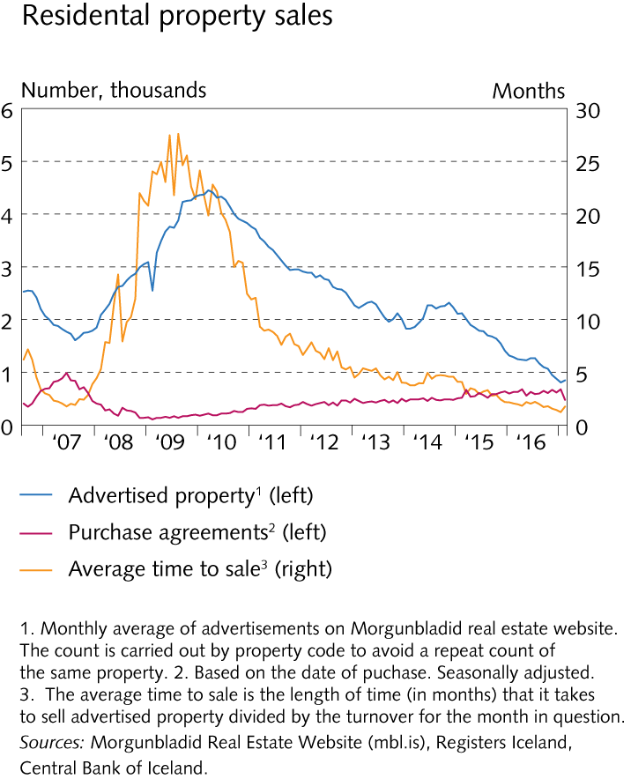
Key risks

Slide 9
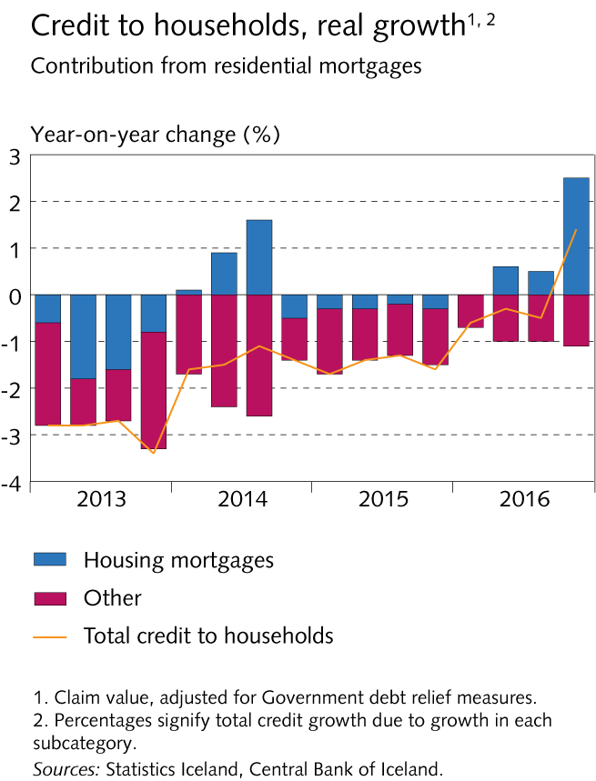
Key risks

Slide 10
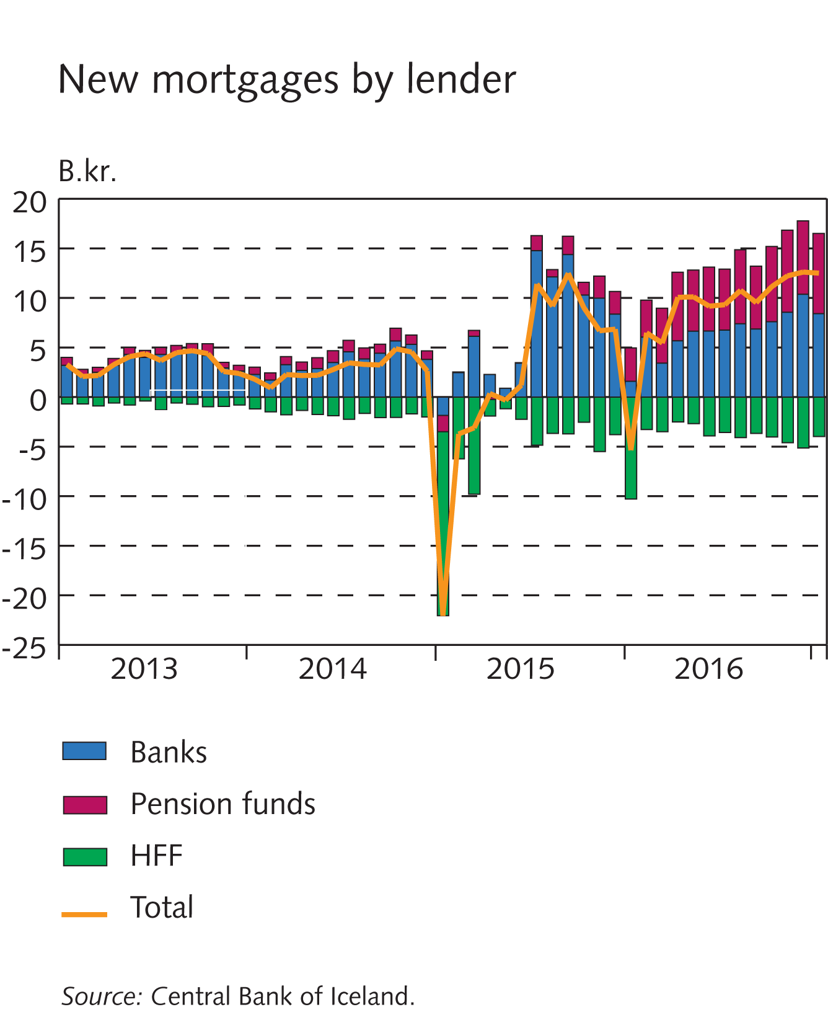
Key risks

Slide 11
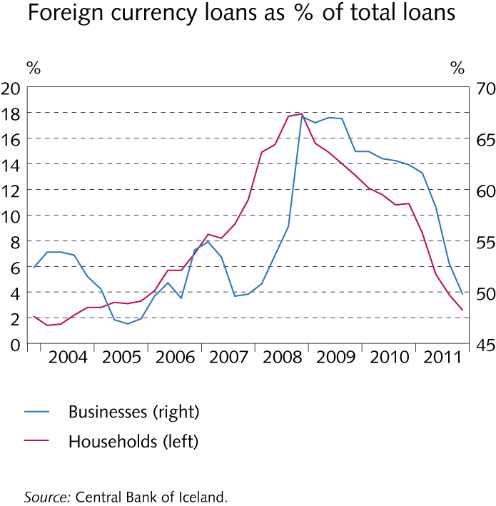
Key risks

Slide 12
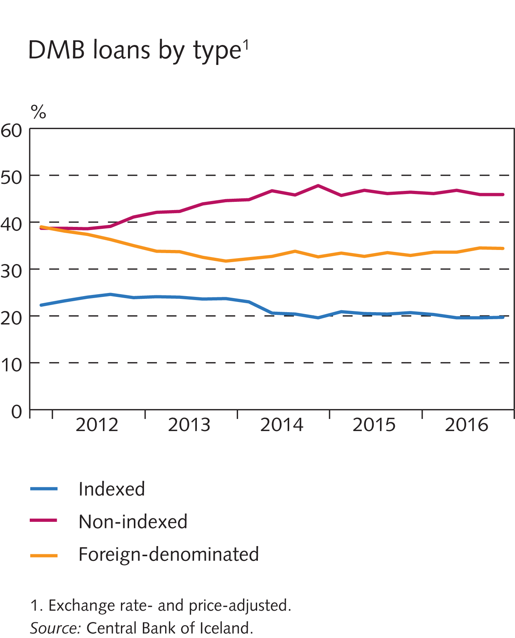
Key risks

Slide 13
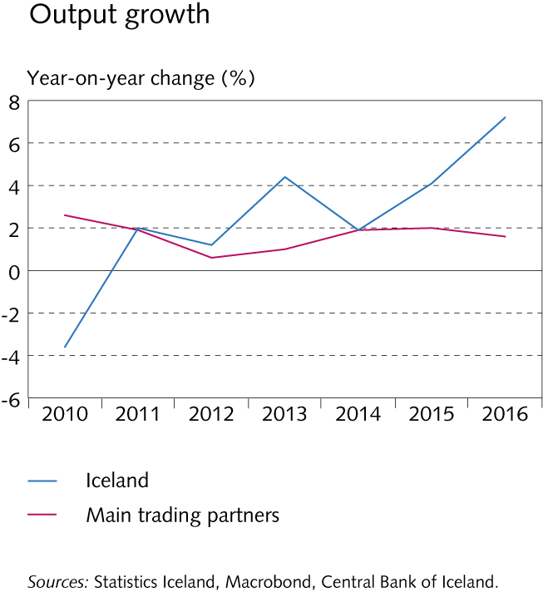
Financial institutions’ operating environment

Slide 14
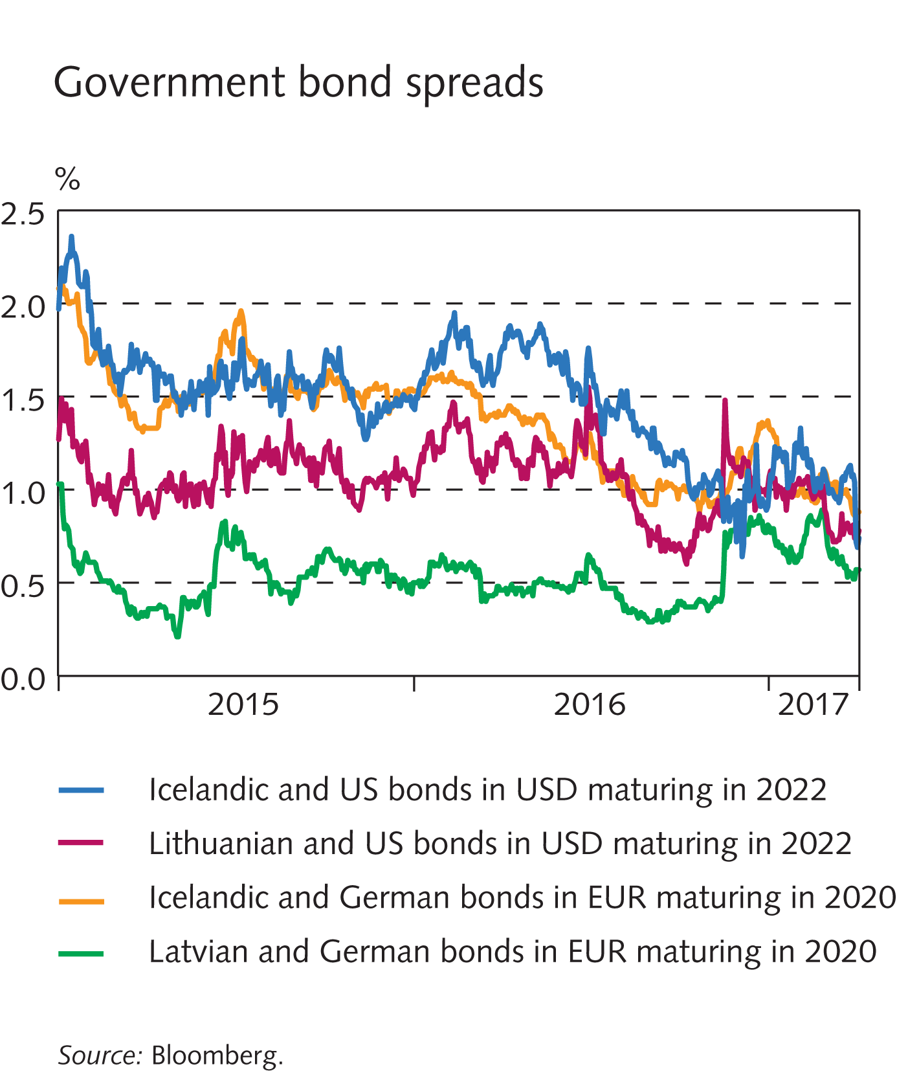
Financial institutions’ operating environment

Slide 15
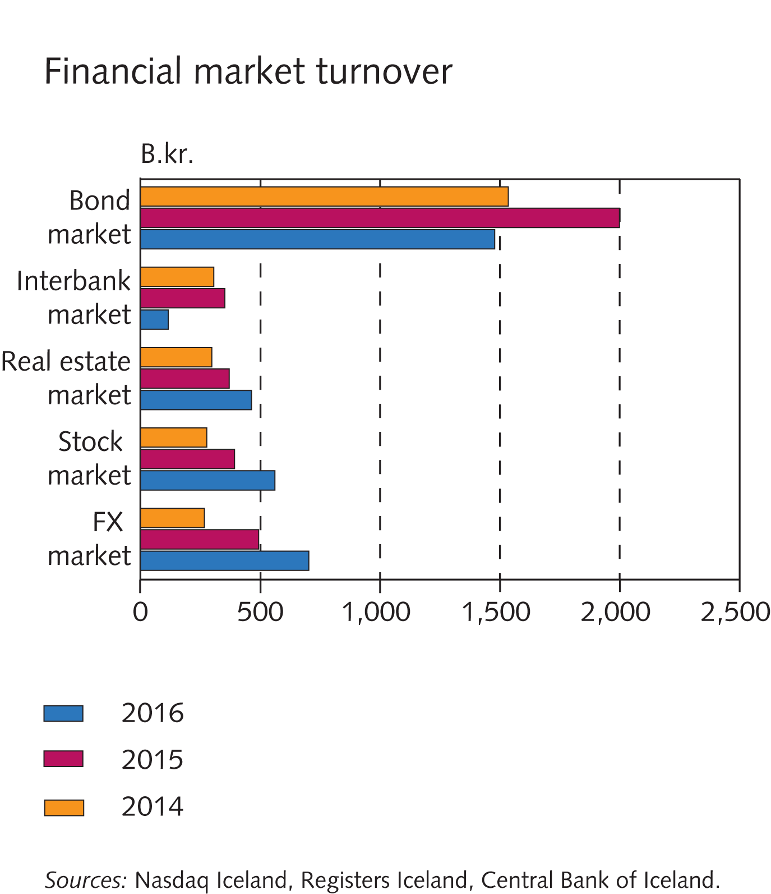
Financial institutions’ operating environment

Slide 16
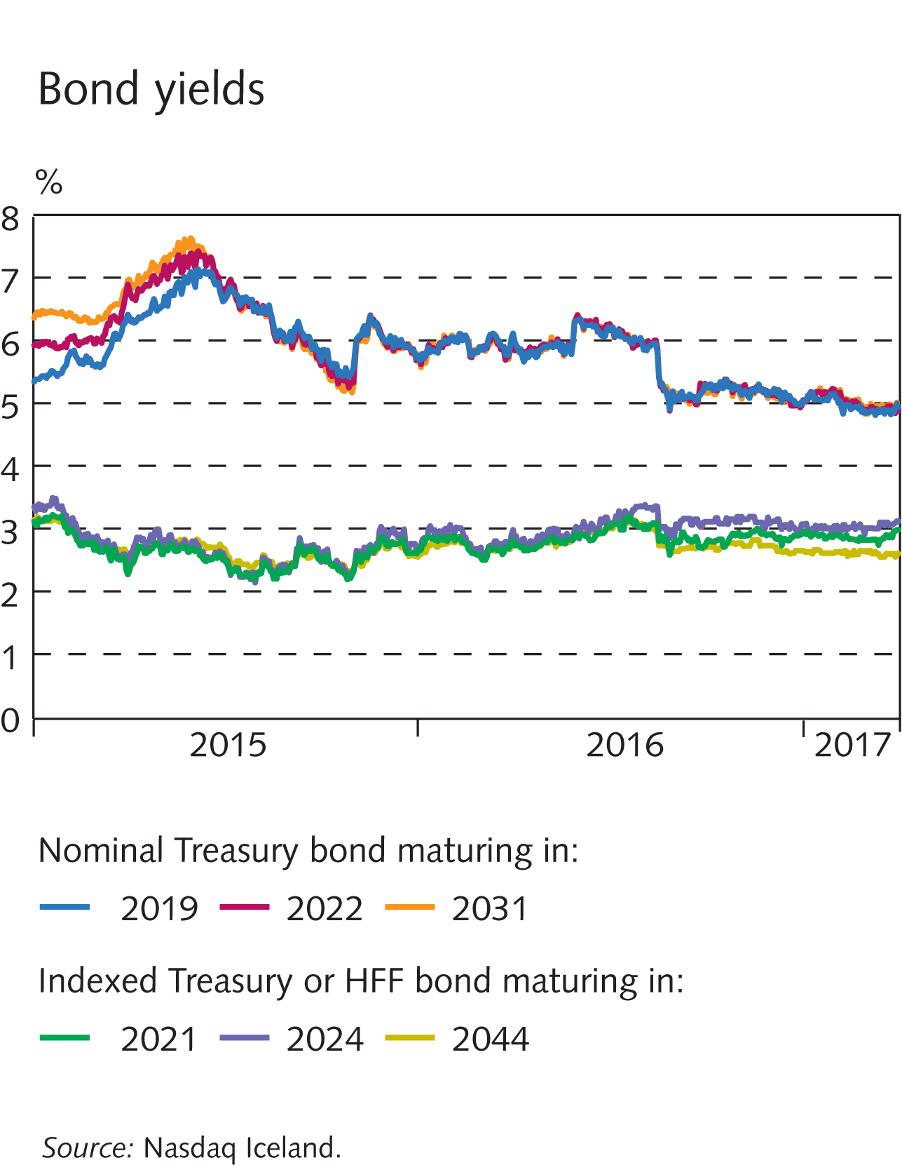
Financial institutions’ operating environment

Slide 17
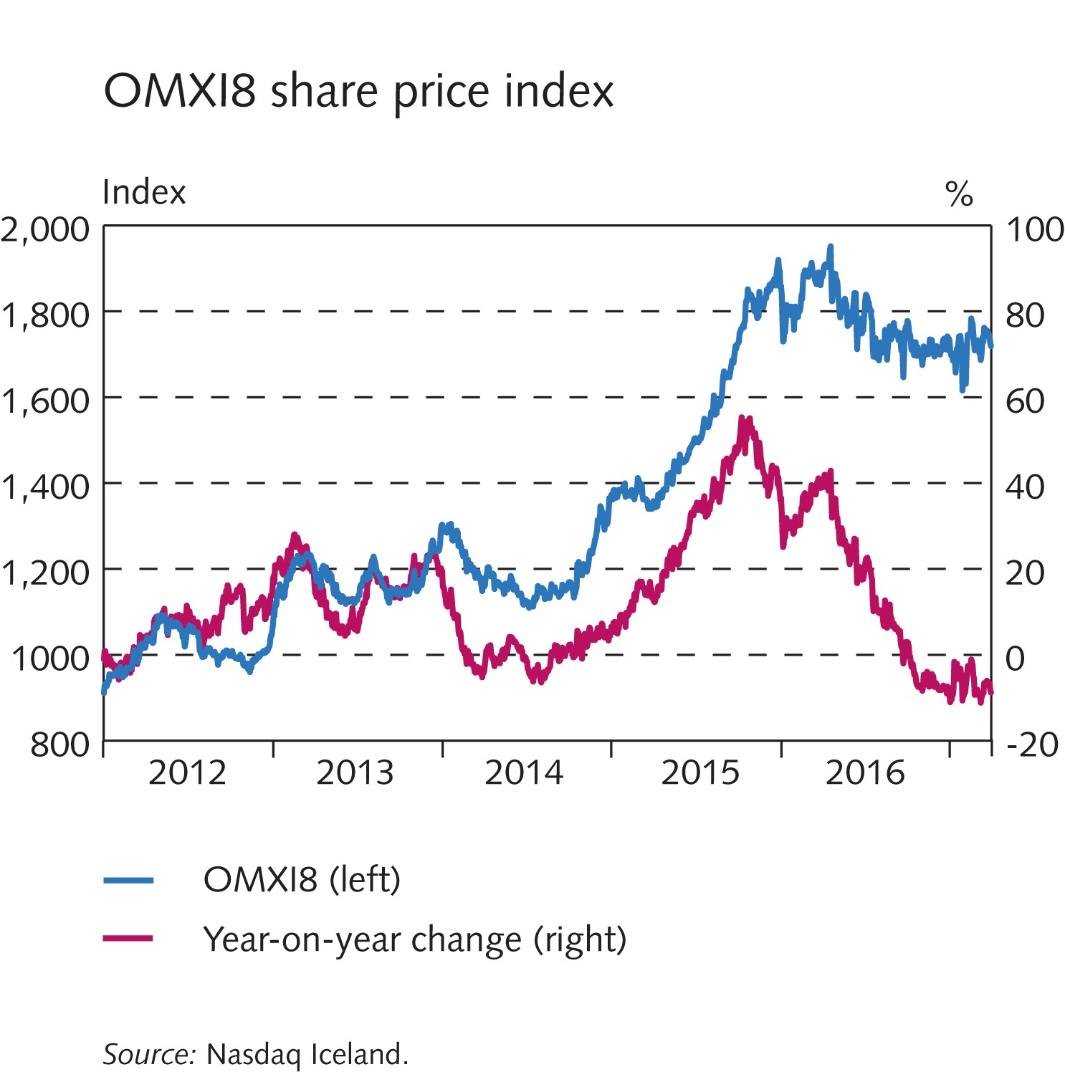
Financial institutions’ operating environment

Slide 18
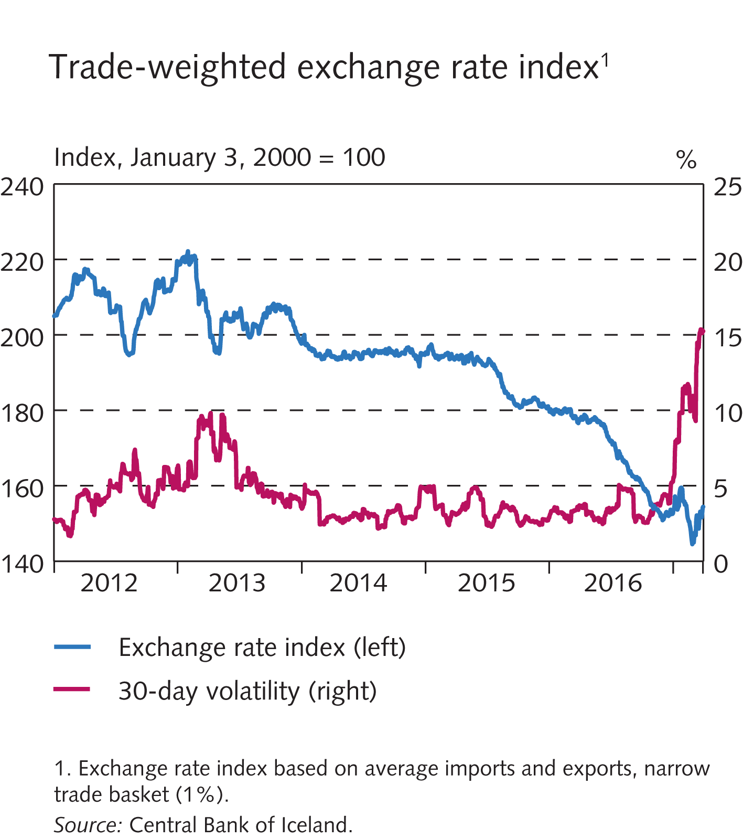
Financial institutions’ operating environment

Slide 19
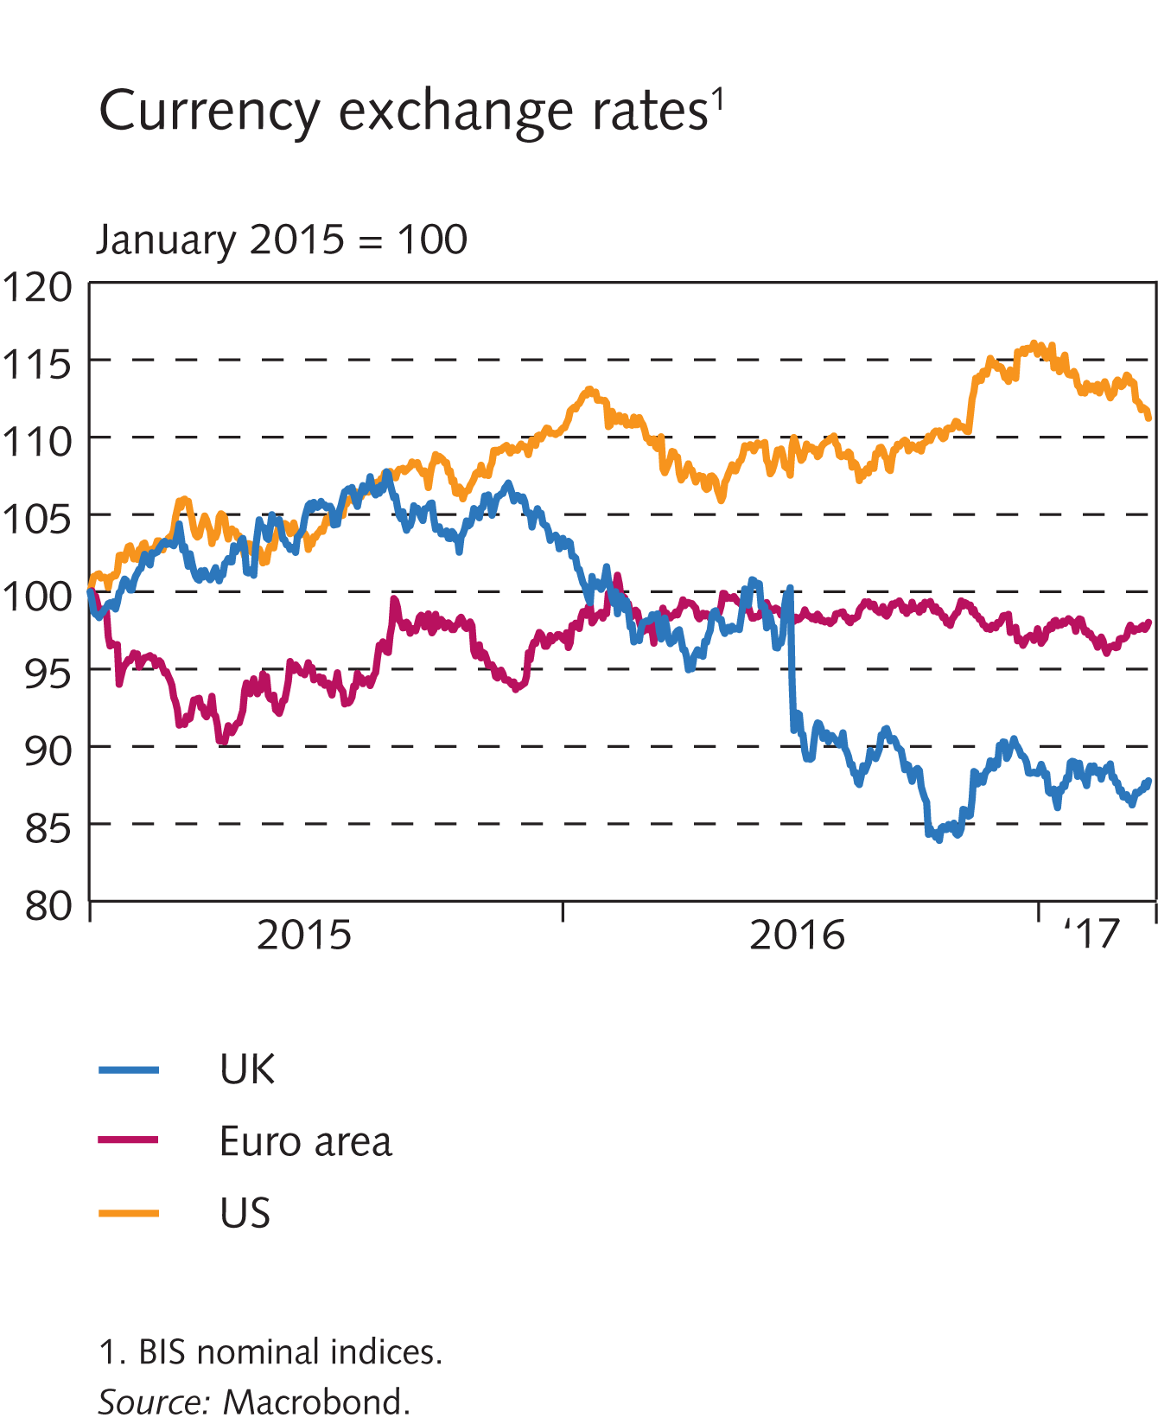
Financial institutions’ operating environment

Slide 20
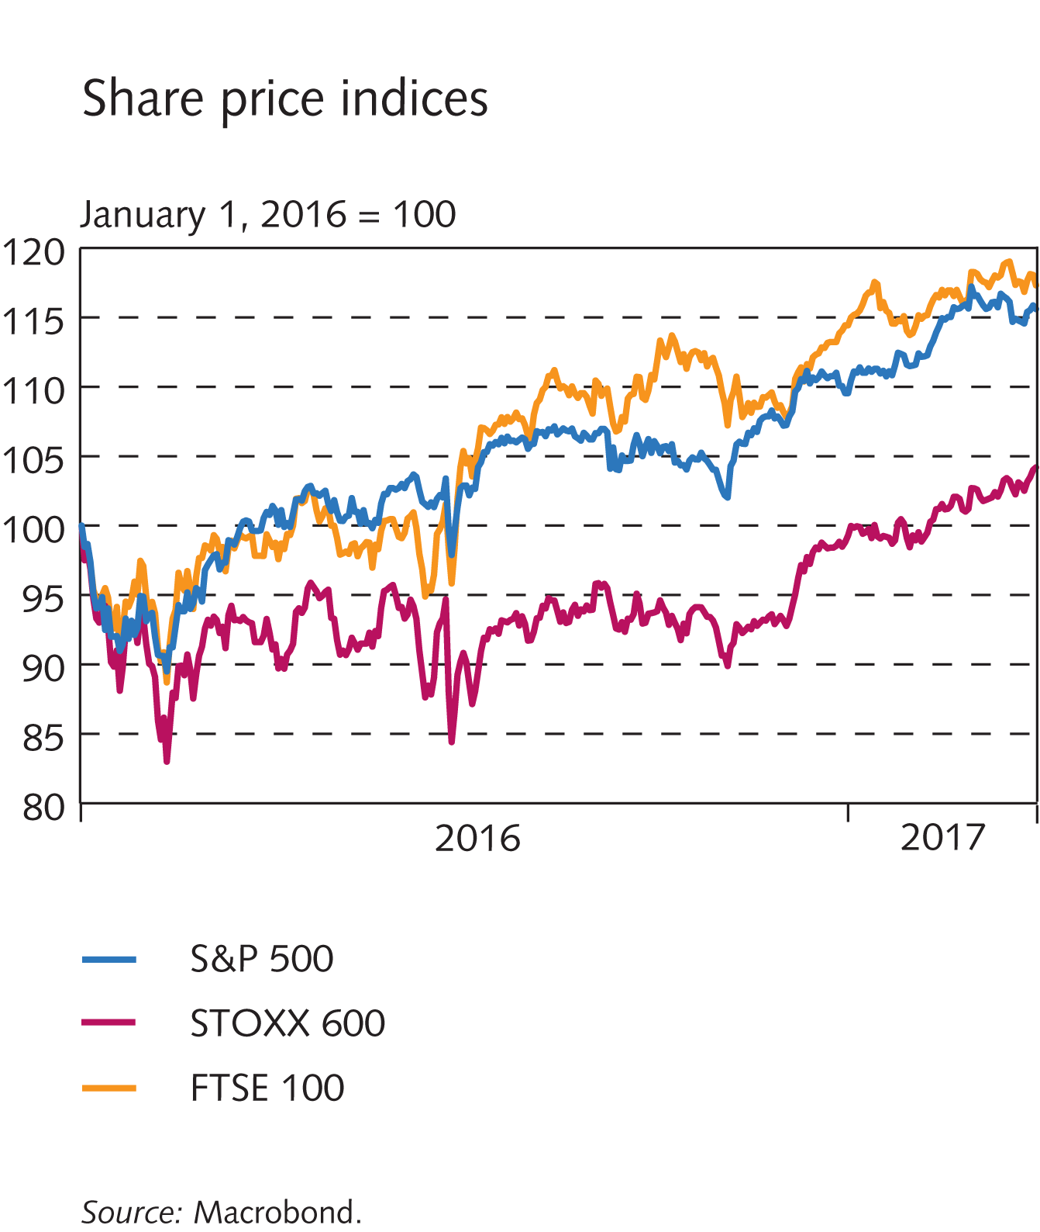
Financial institutions’ operating environment

Slide 21
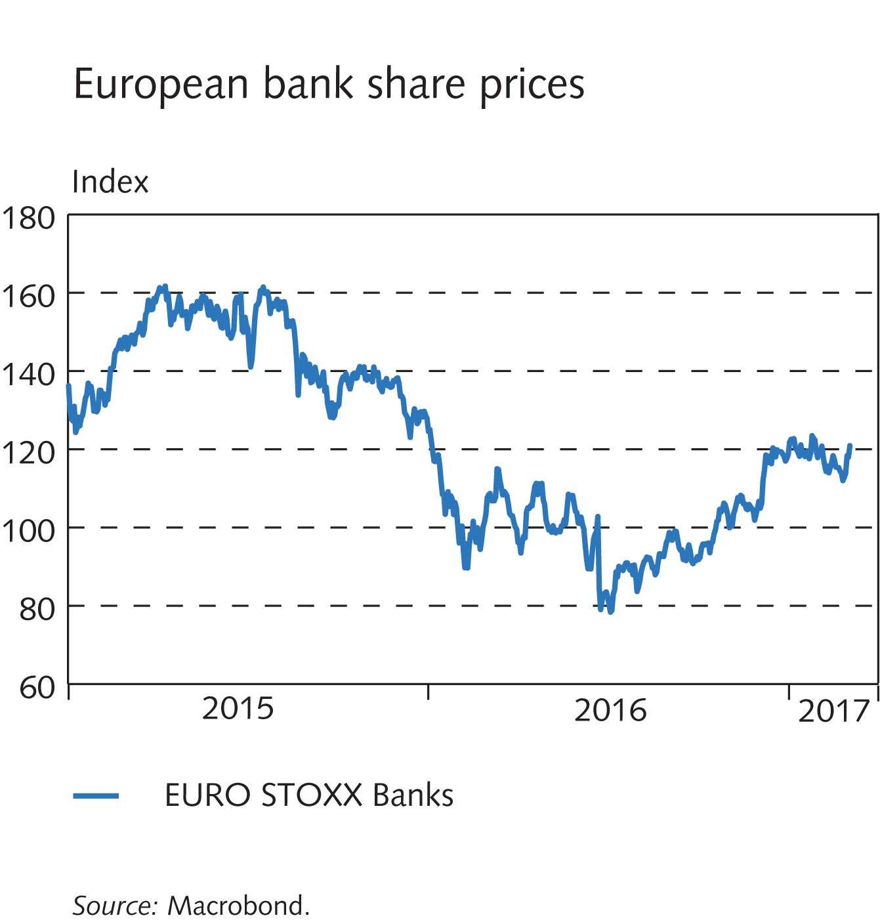
Financial institutions’ operating environment

Slide 22
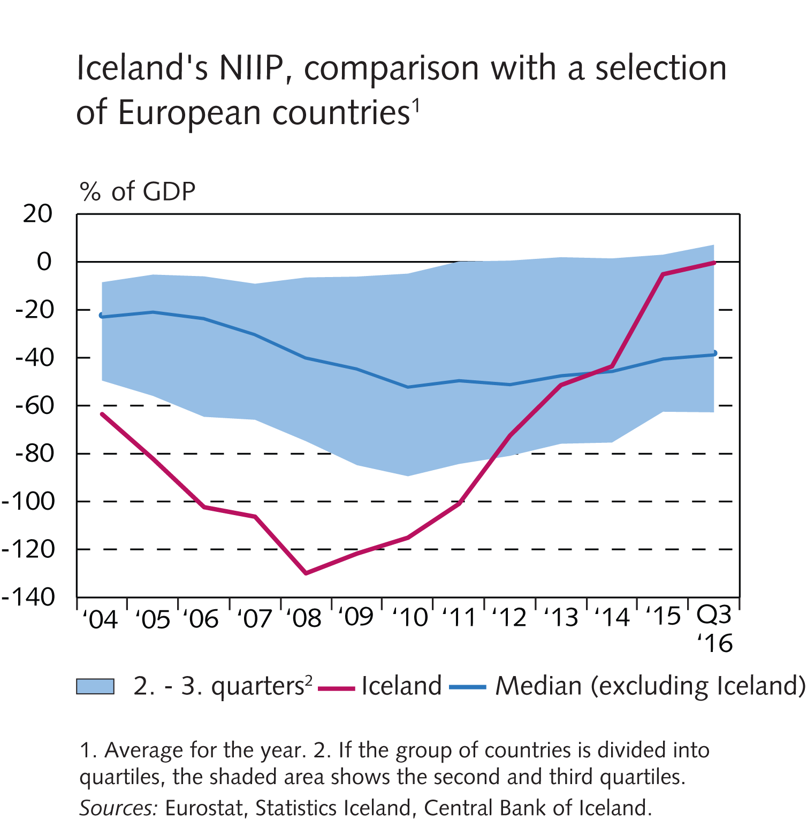
Financial institutions’ operating environment

Slide 23
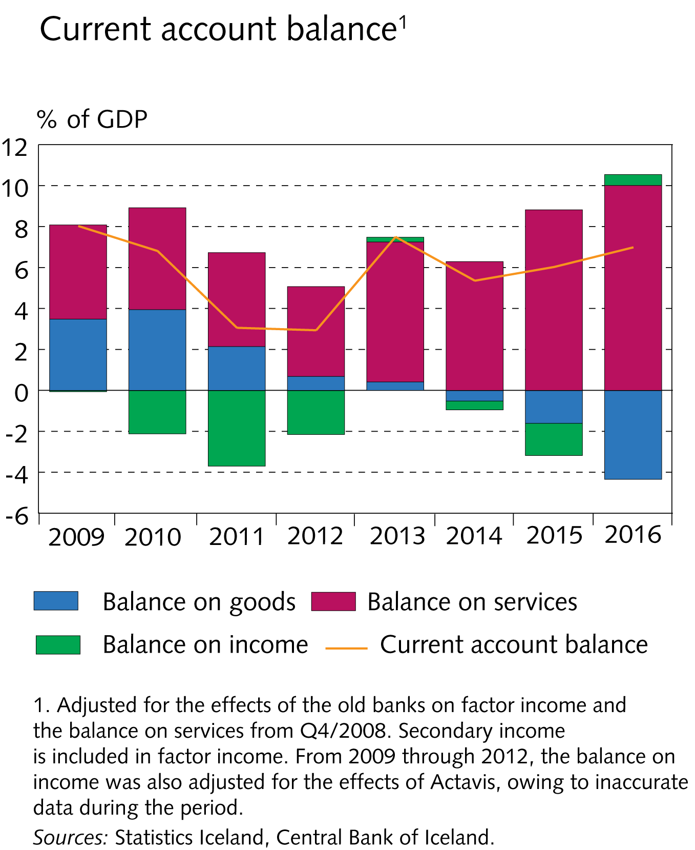
Financial institutions’ operating environment

Slide 24
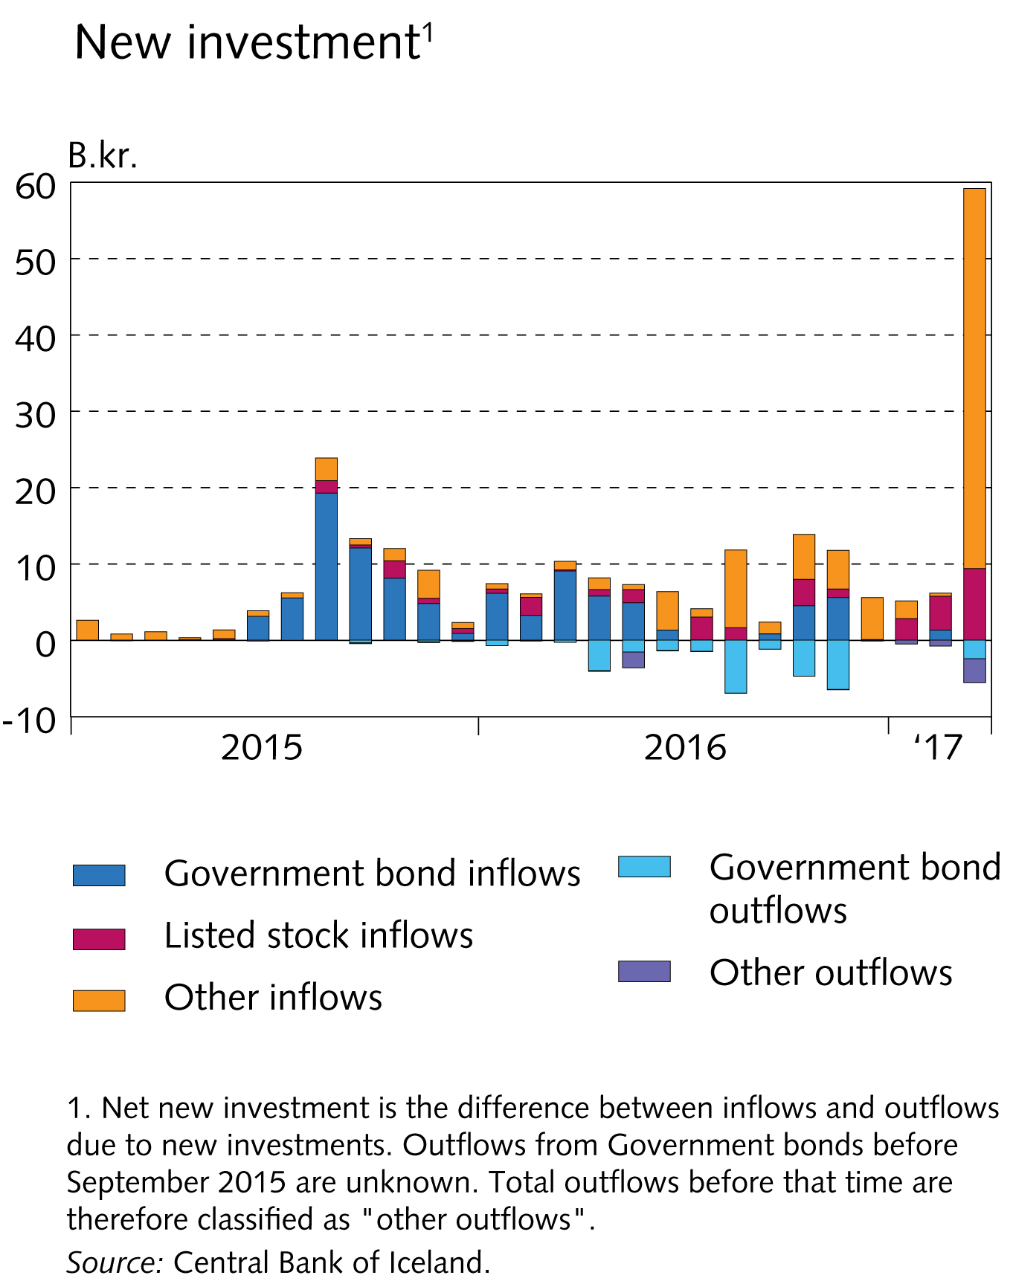
Box II-2

Slide 25
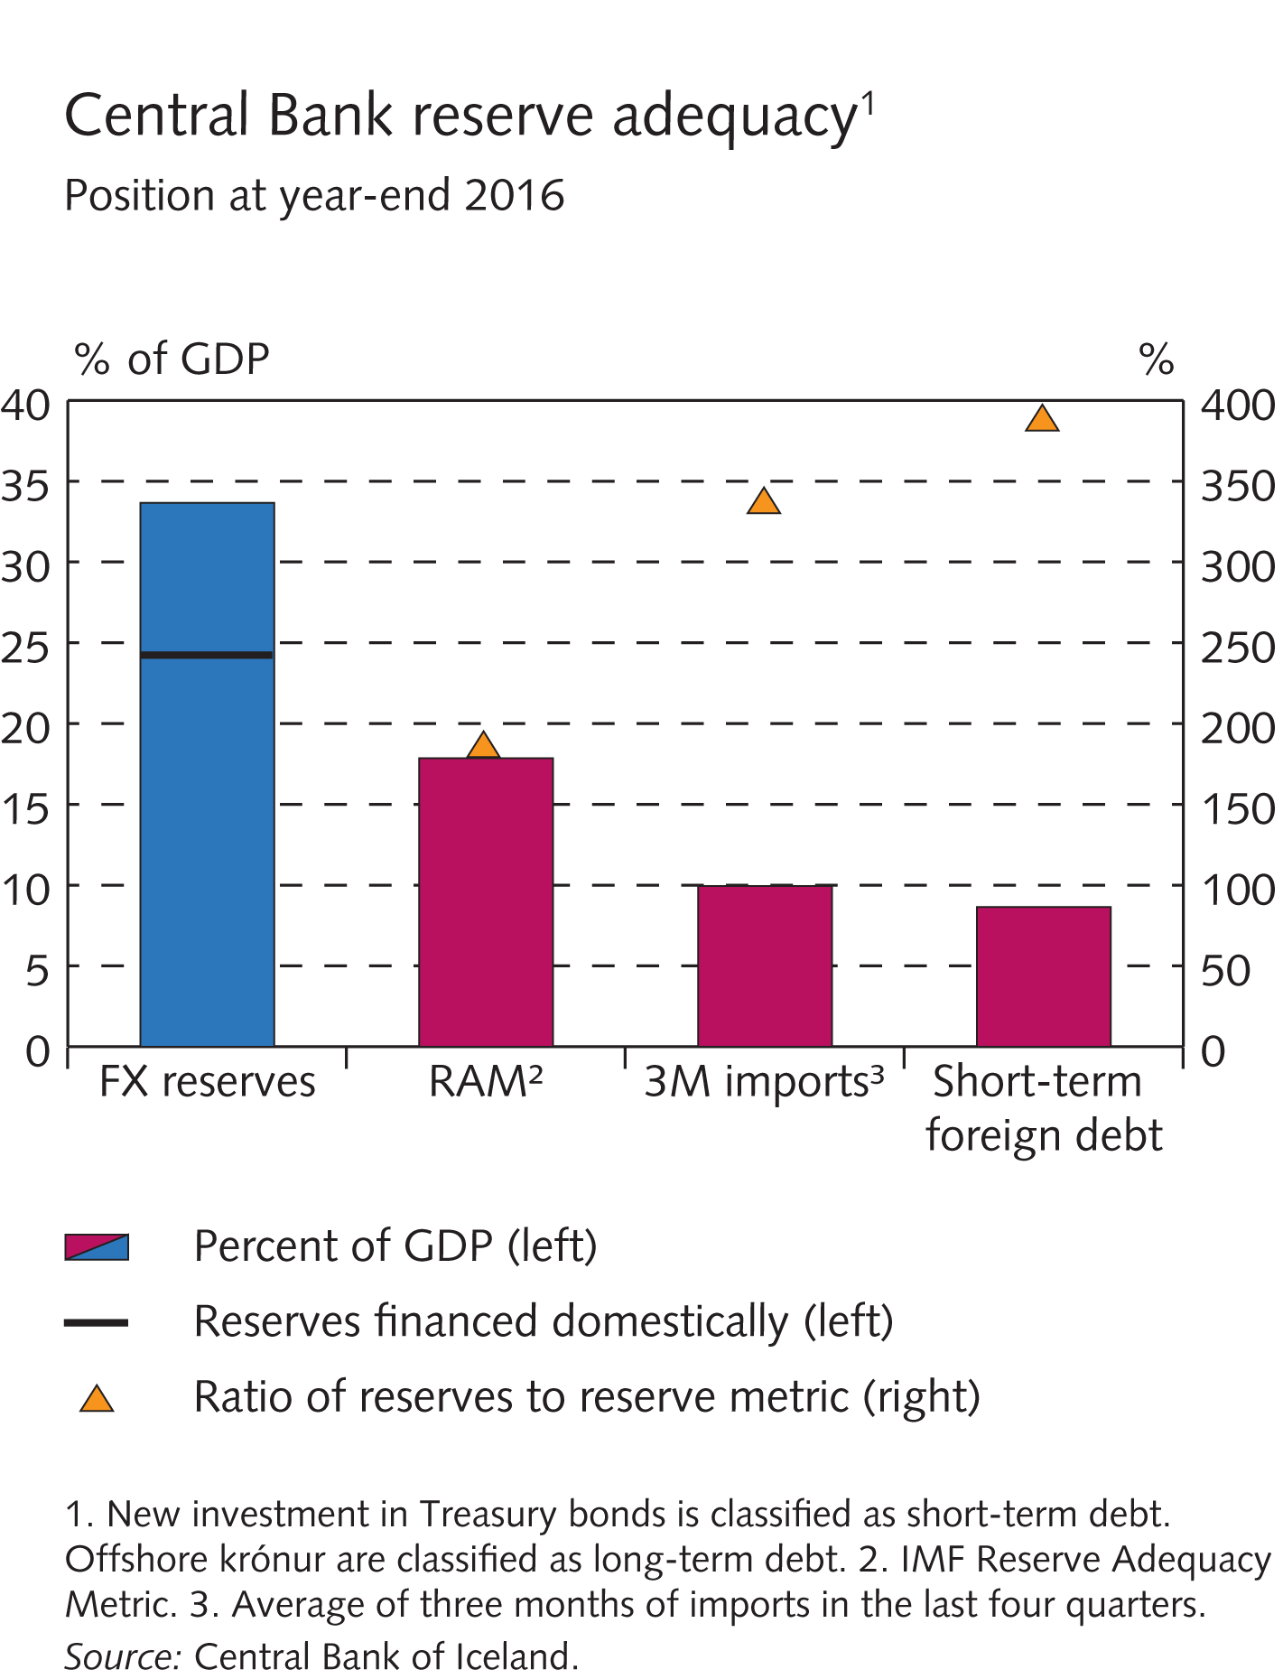
Box II-3

Slide 26
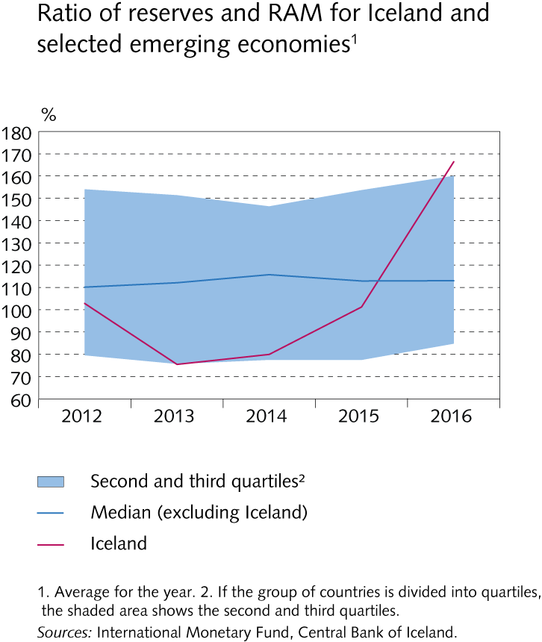
Box II-3

Slide 27
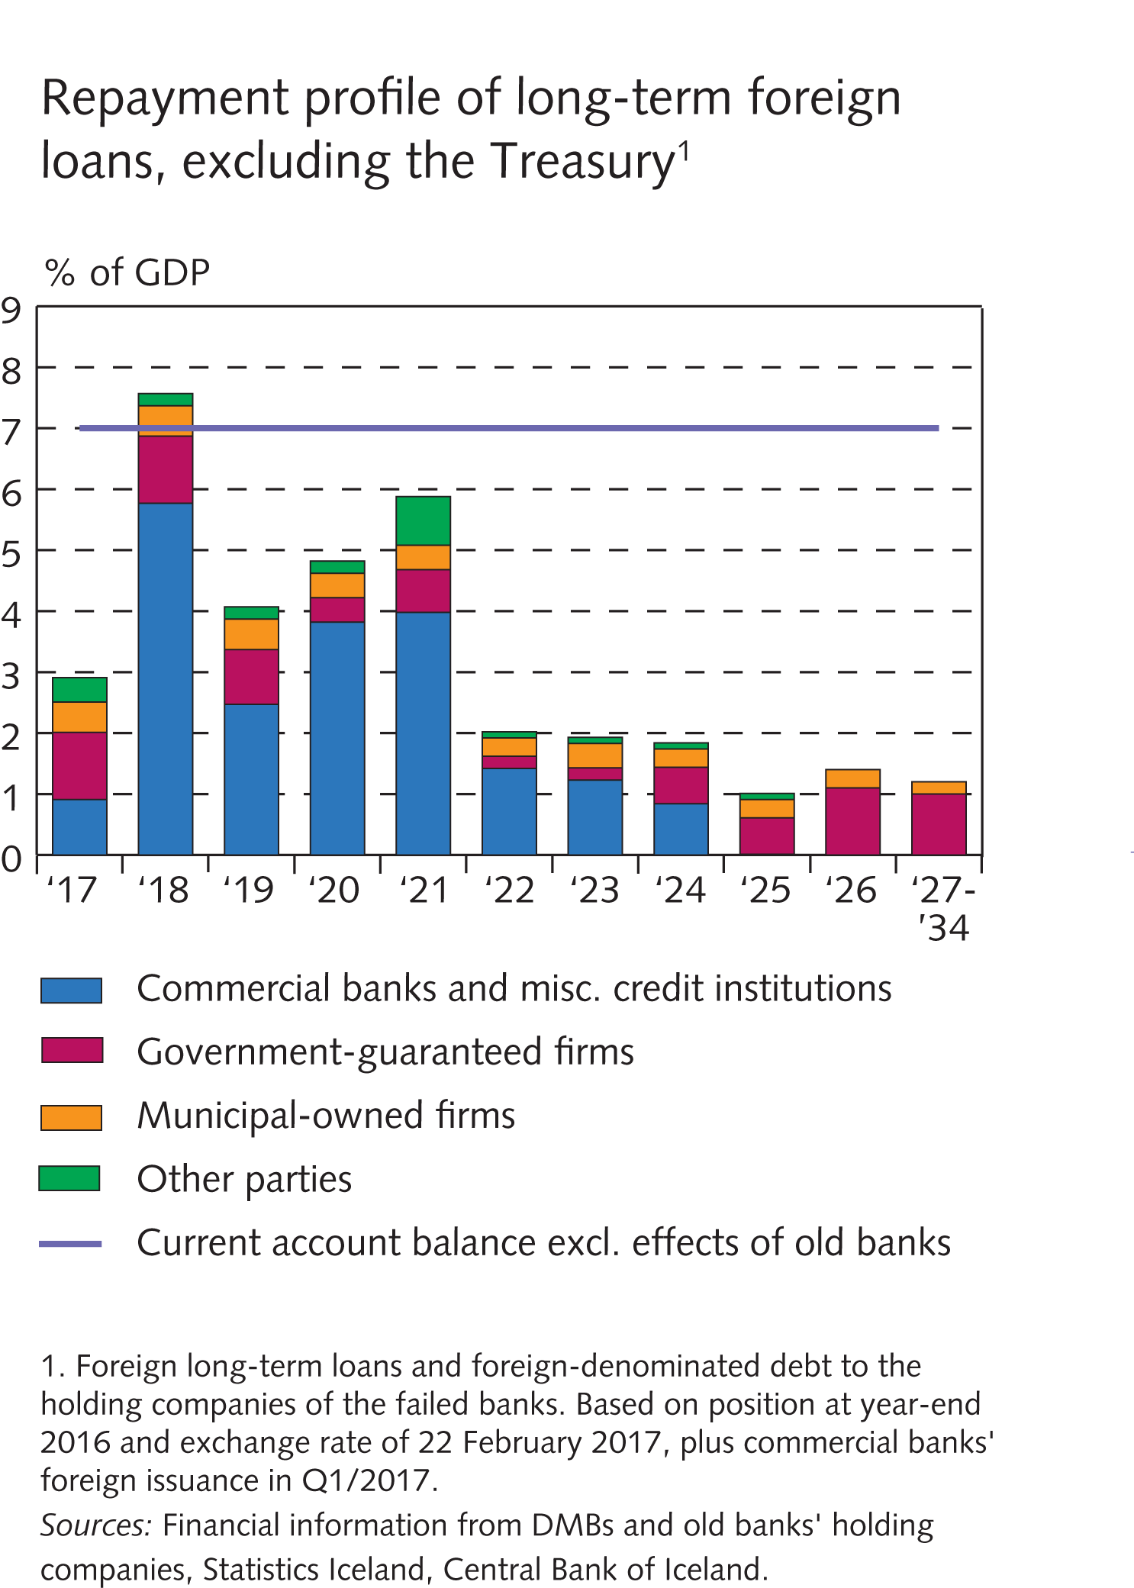
Financial institutions’ operating environment

Slide 28
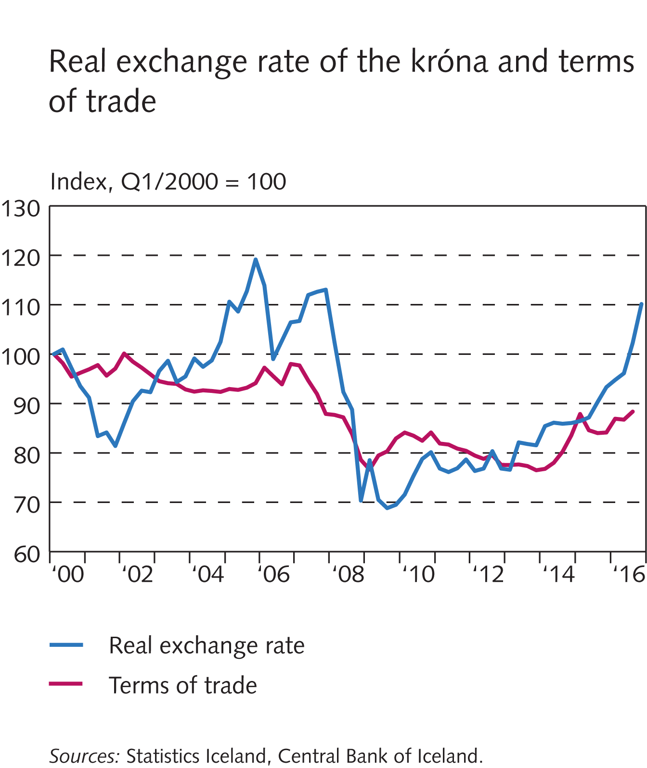
Box II-4

Slide 29
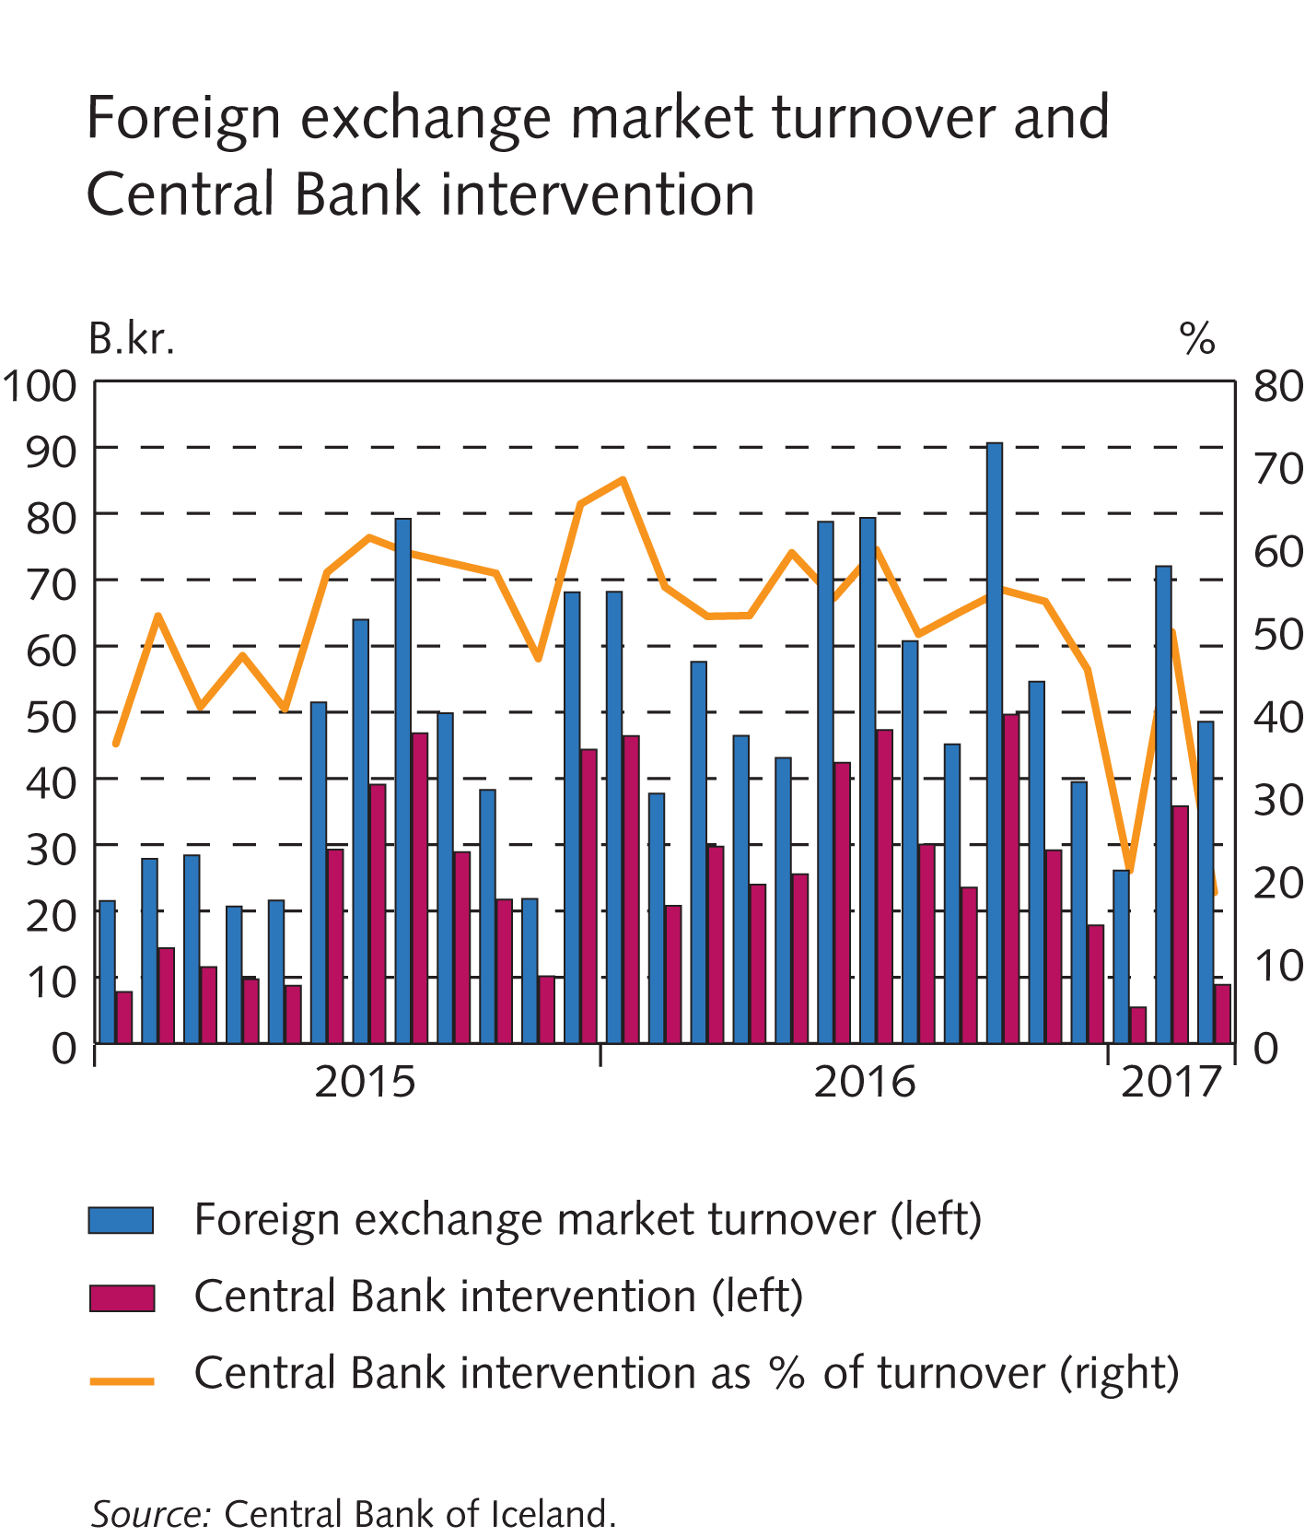
Box II-4

Slide 30
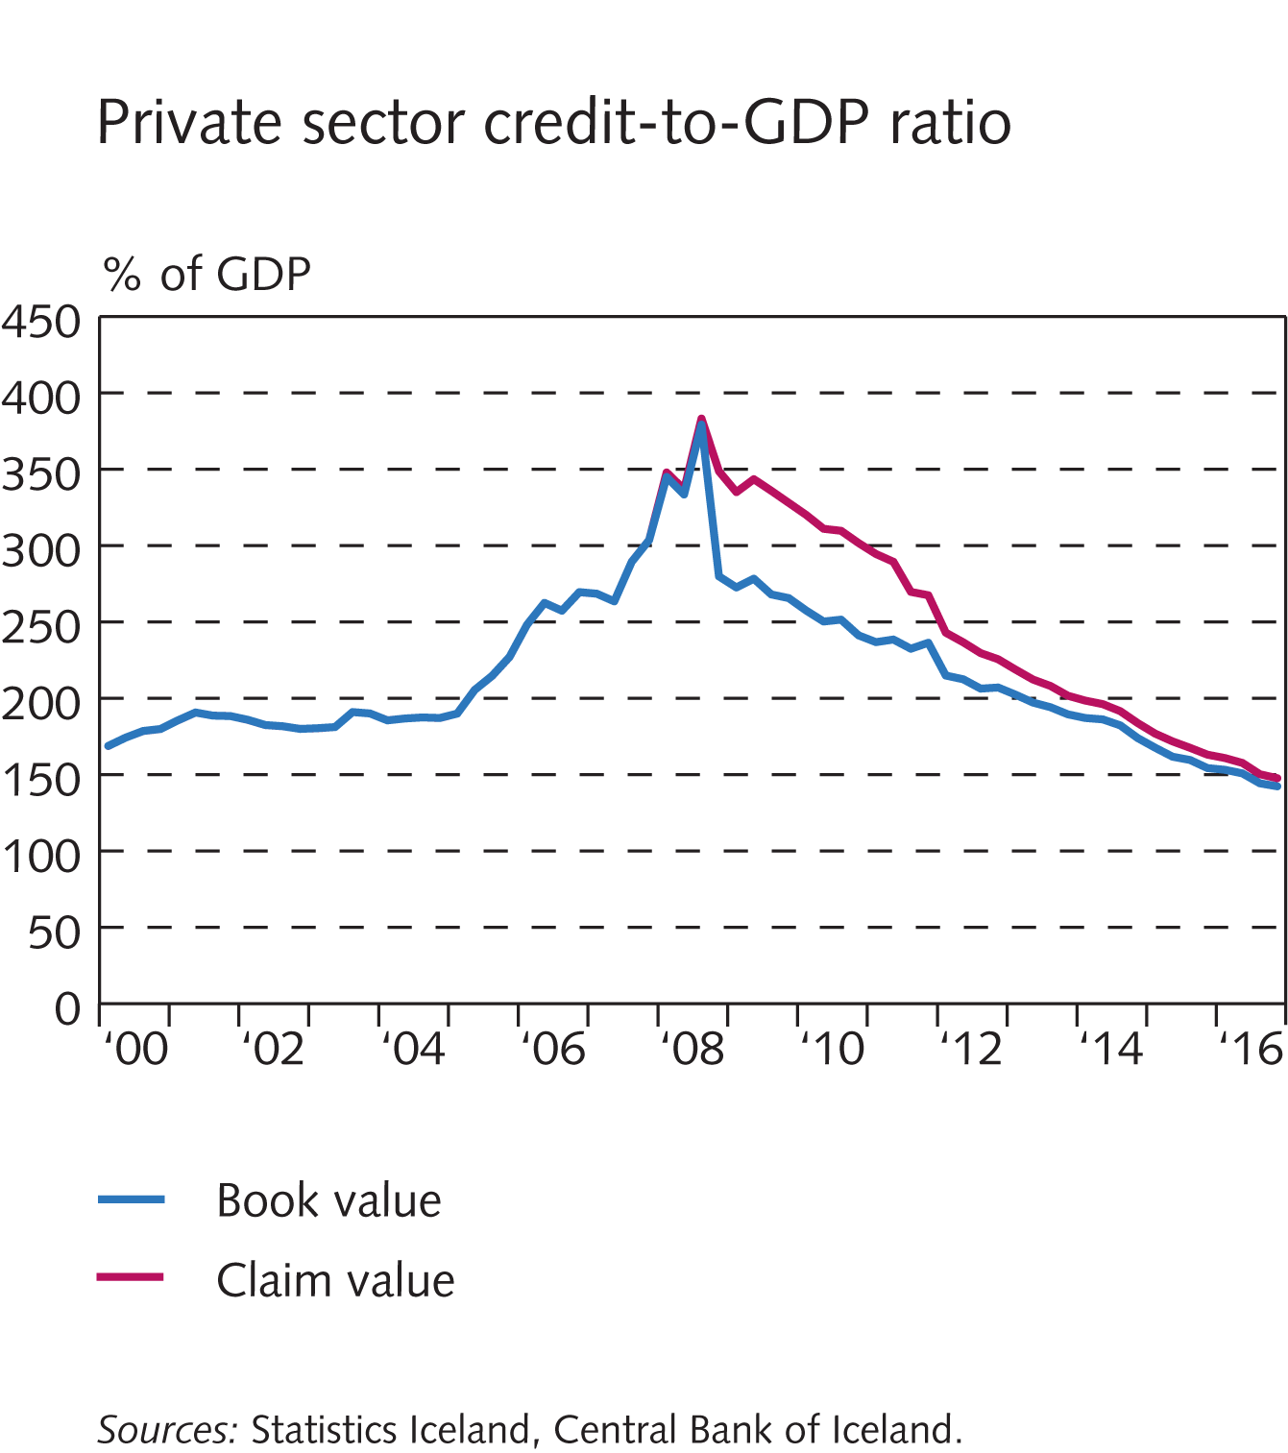
Financial institutions’ operating environment

Slide 31
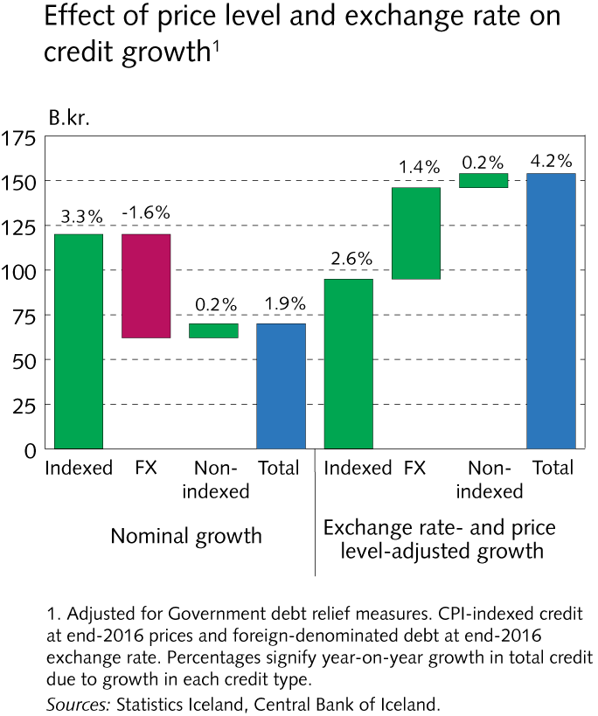
Financial institutions’ operating environment

Slide 32
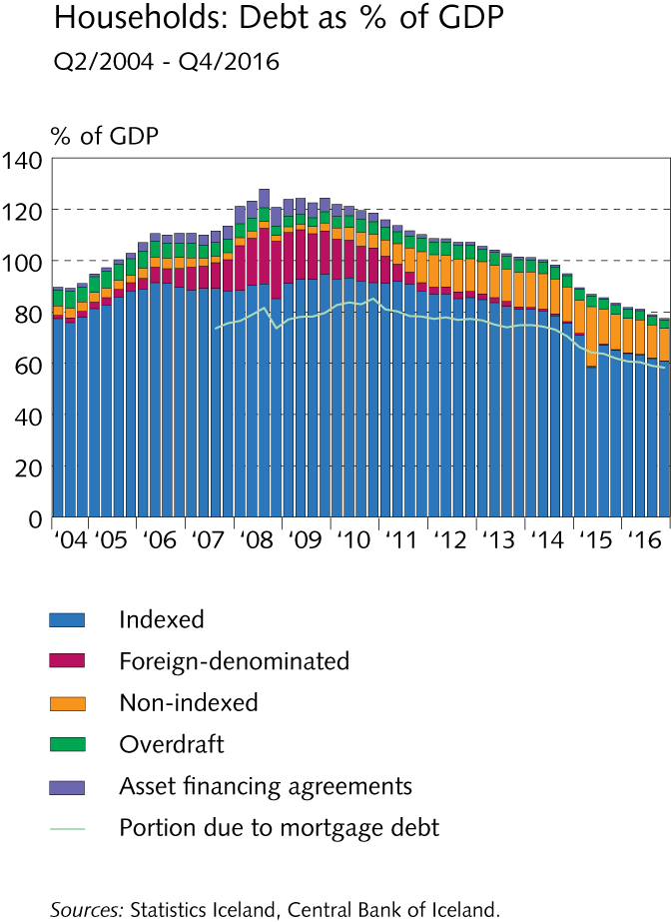
Financial institutions’ operating environment

Slide 33
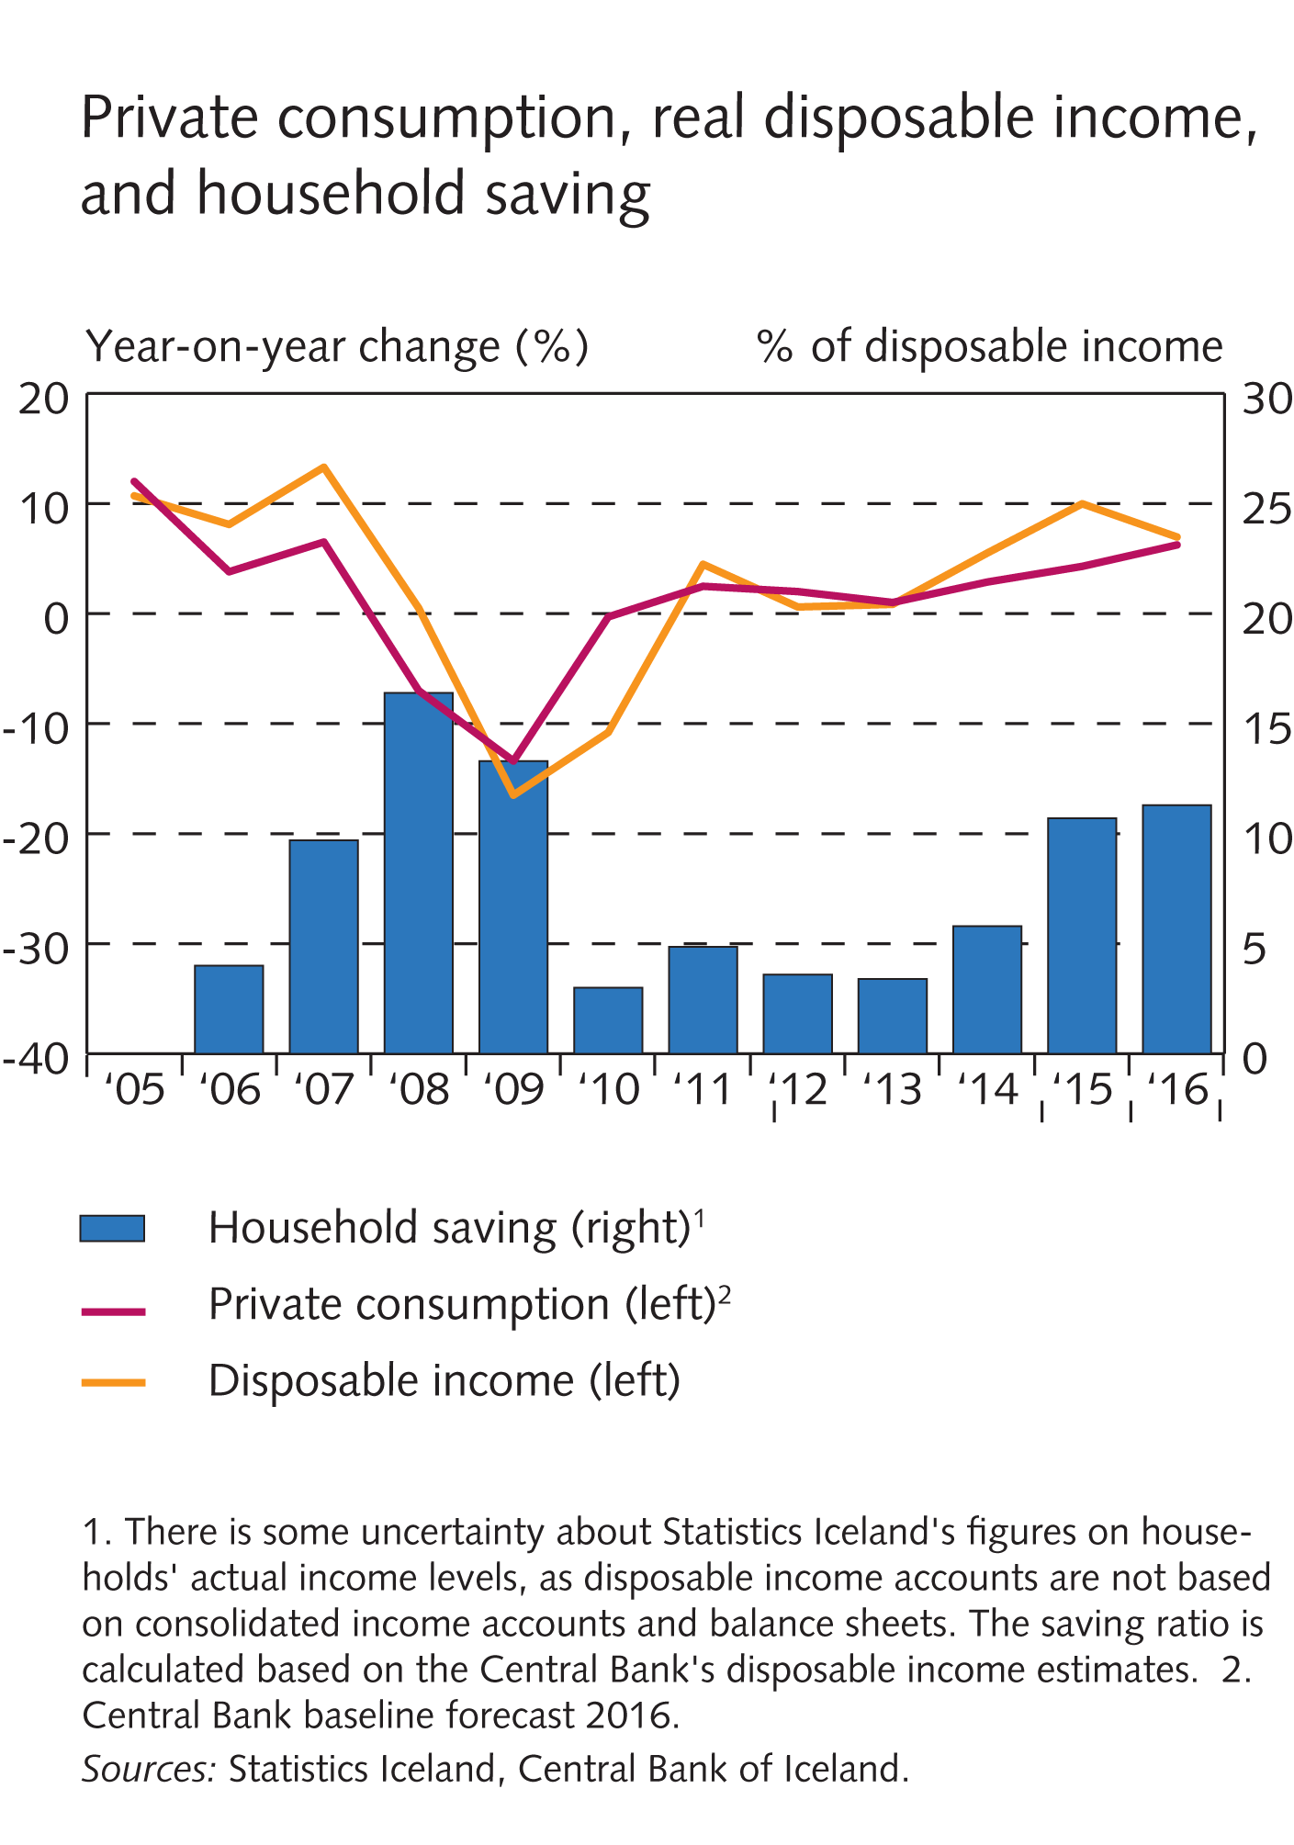
Financial institutions’ operating environment

Slide 34
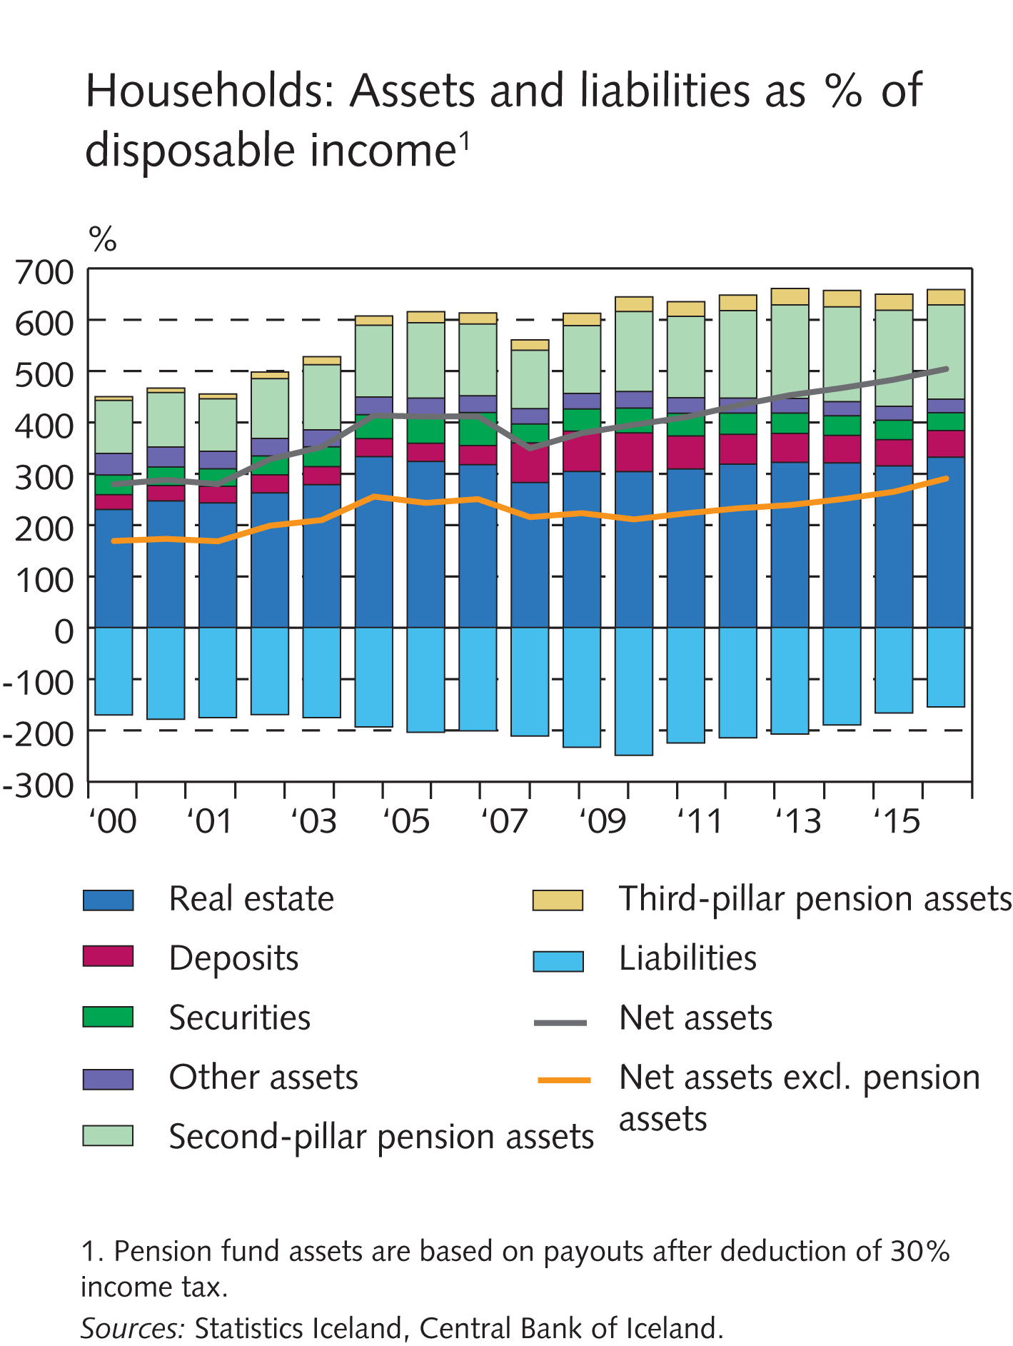
Financial institutions’ operating environment

Slide 35
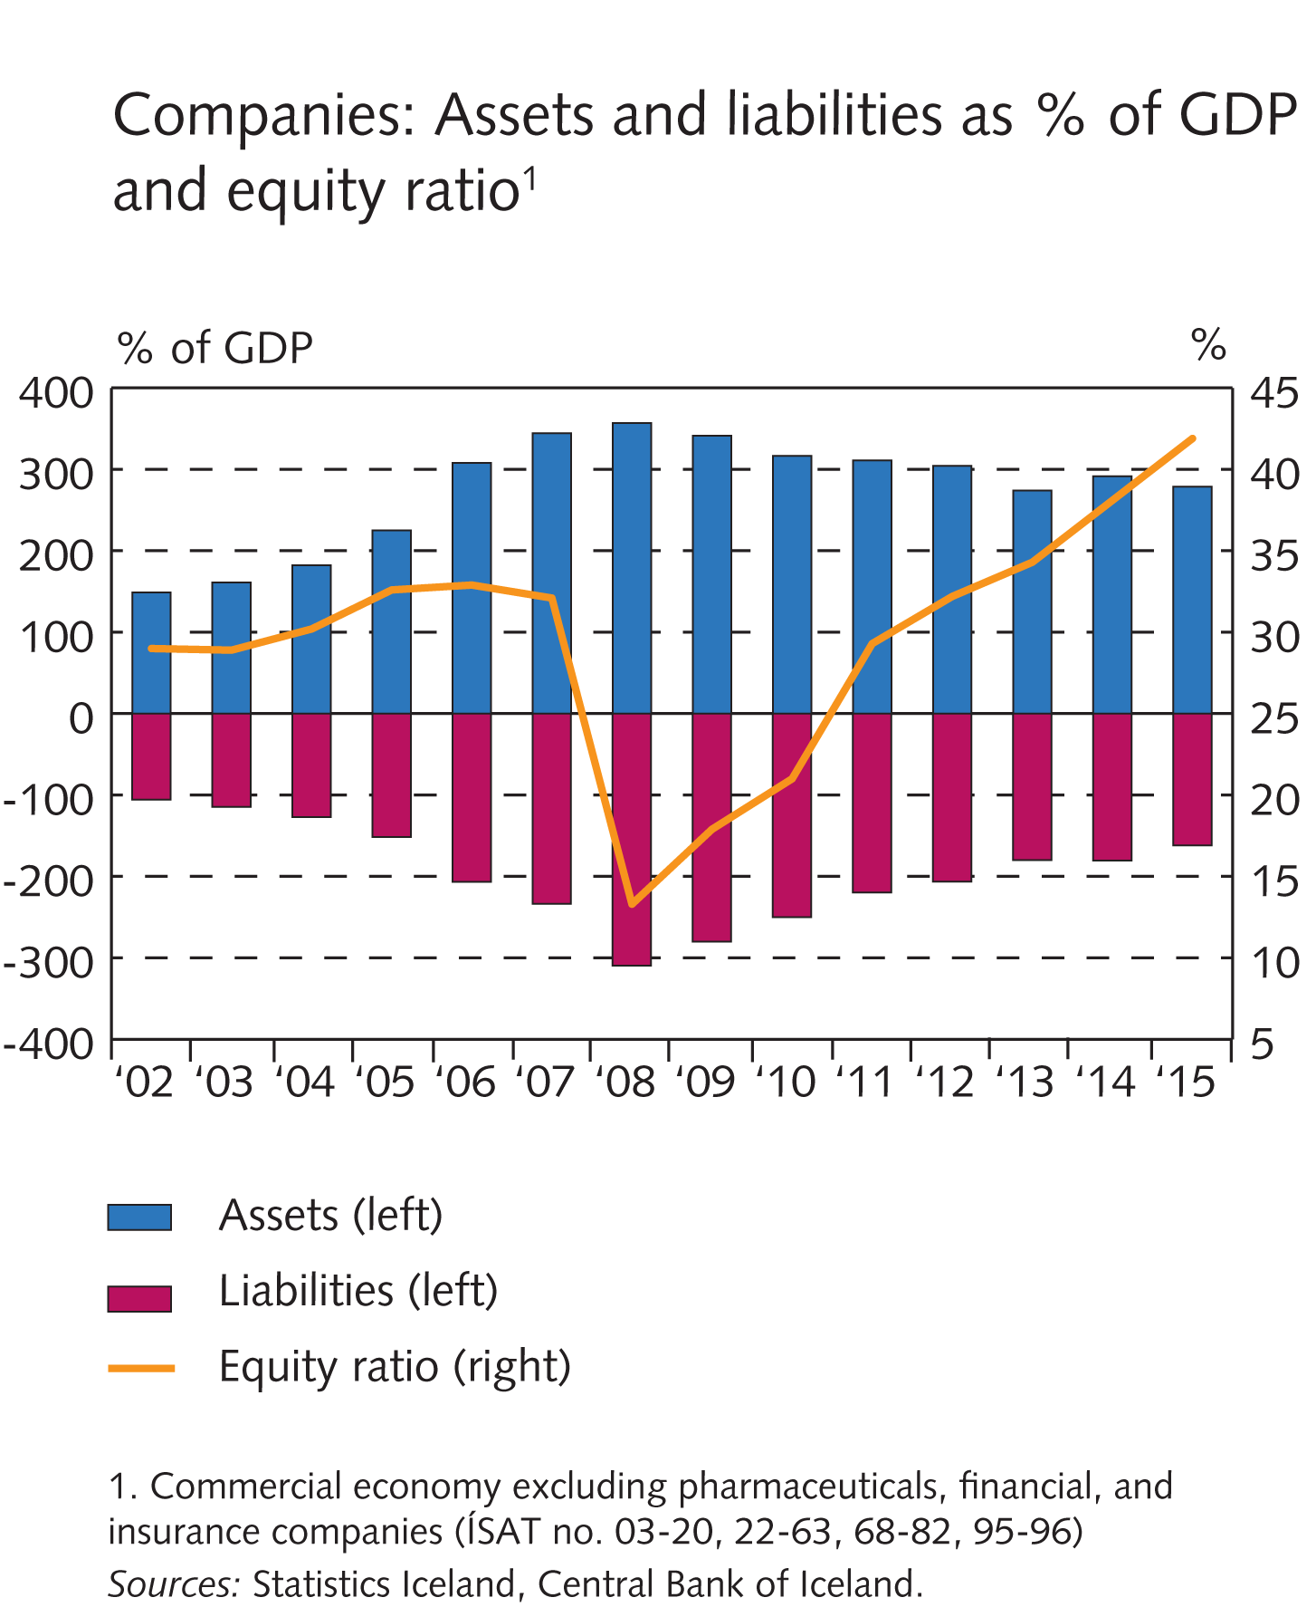
Financial institutions’ operating environment

Slide 36
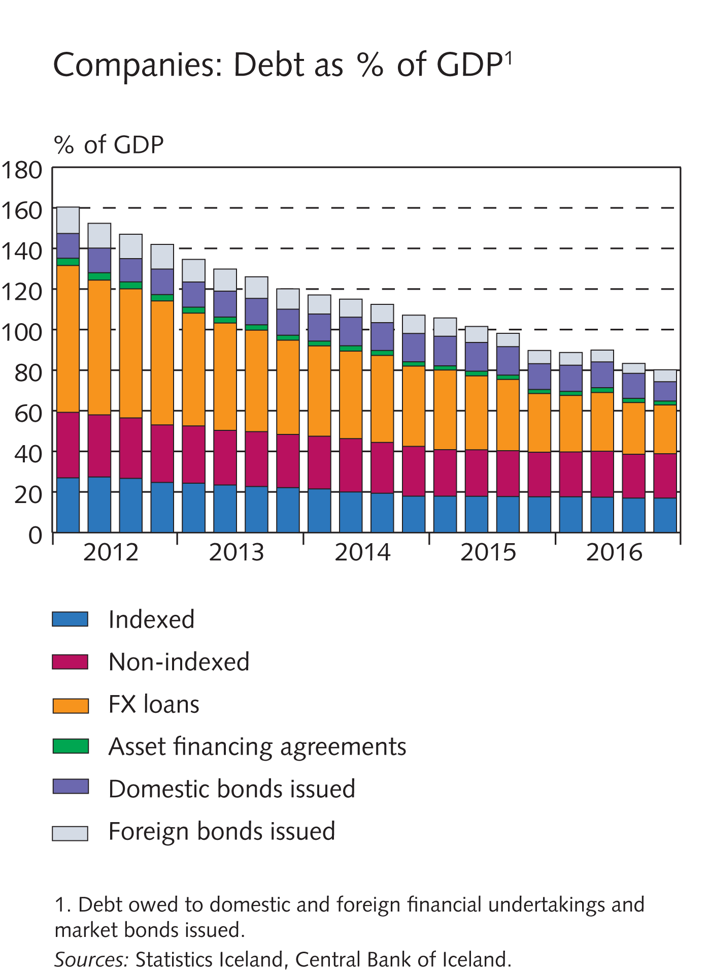
Financial institutions’ operating environment

Slide 37
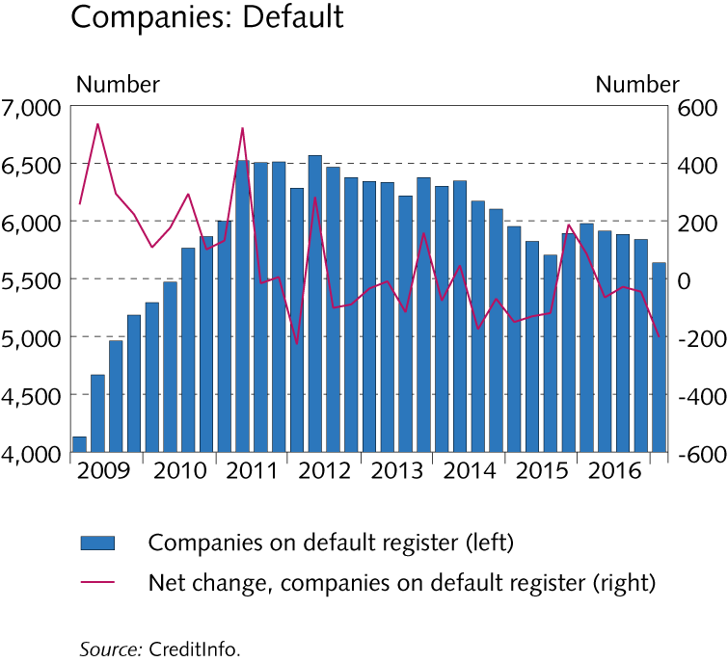
Financial institutions’ operating environment

Slide 38
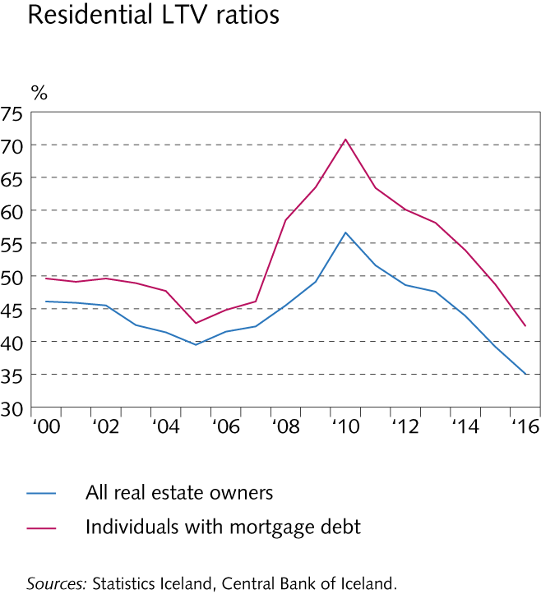
Box II-5

Slide 39
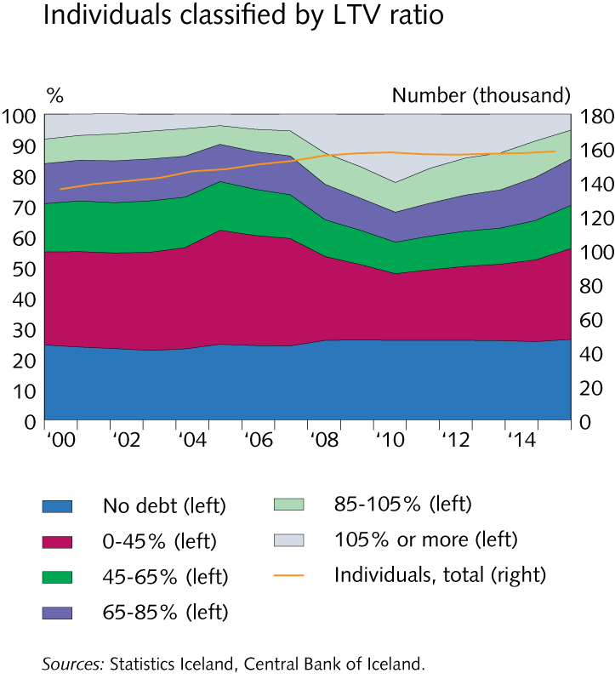
Box II-5

Slide 40
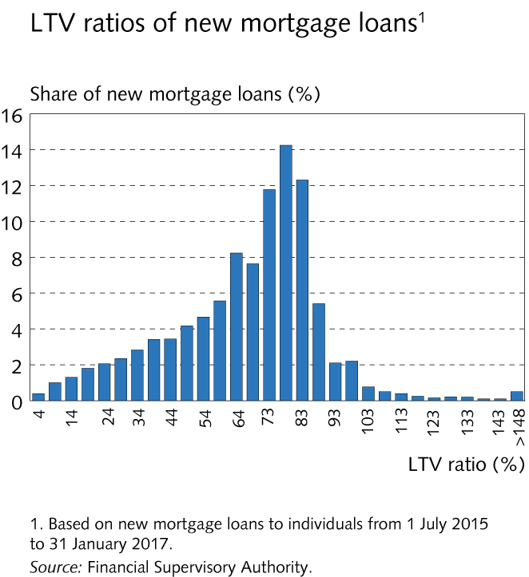
Box II-5

Slide 41
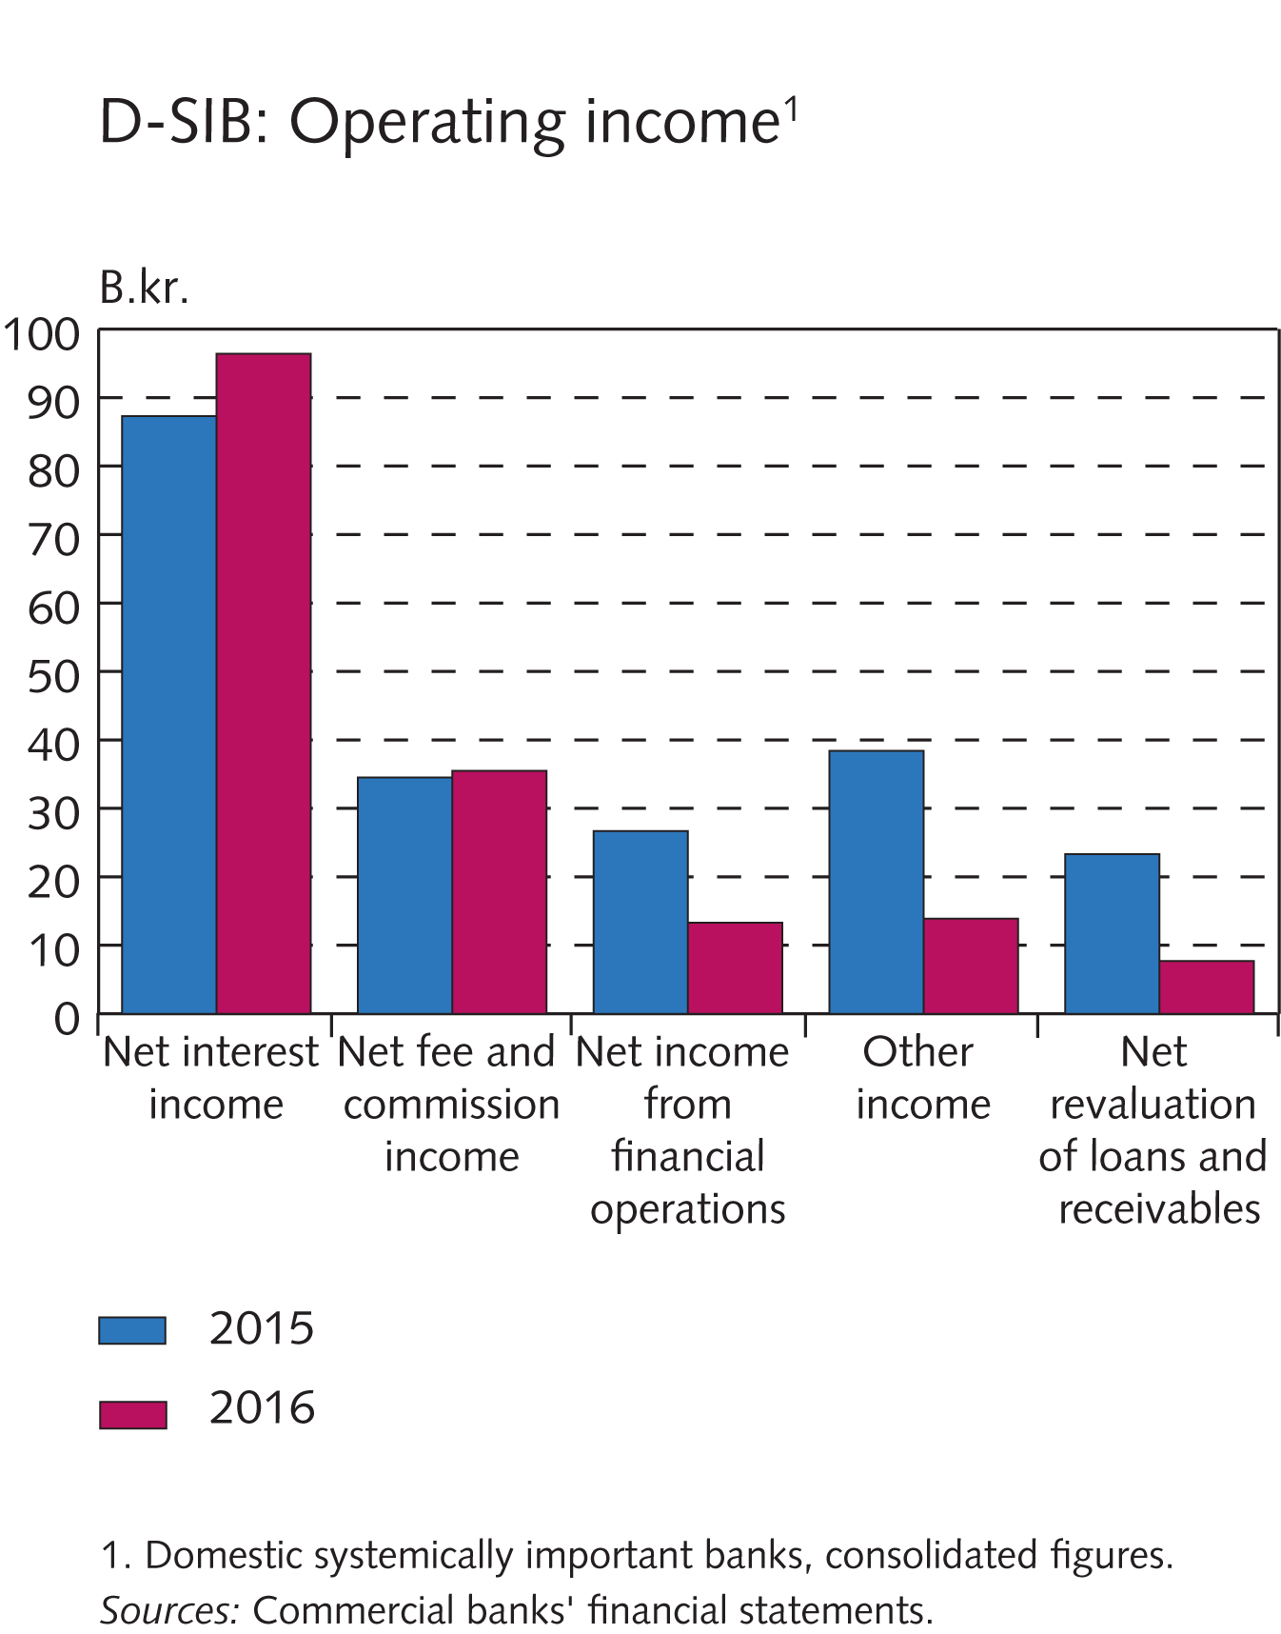
Financial market entities

Slide 42
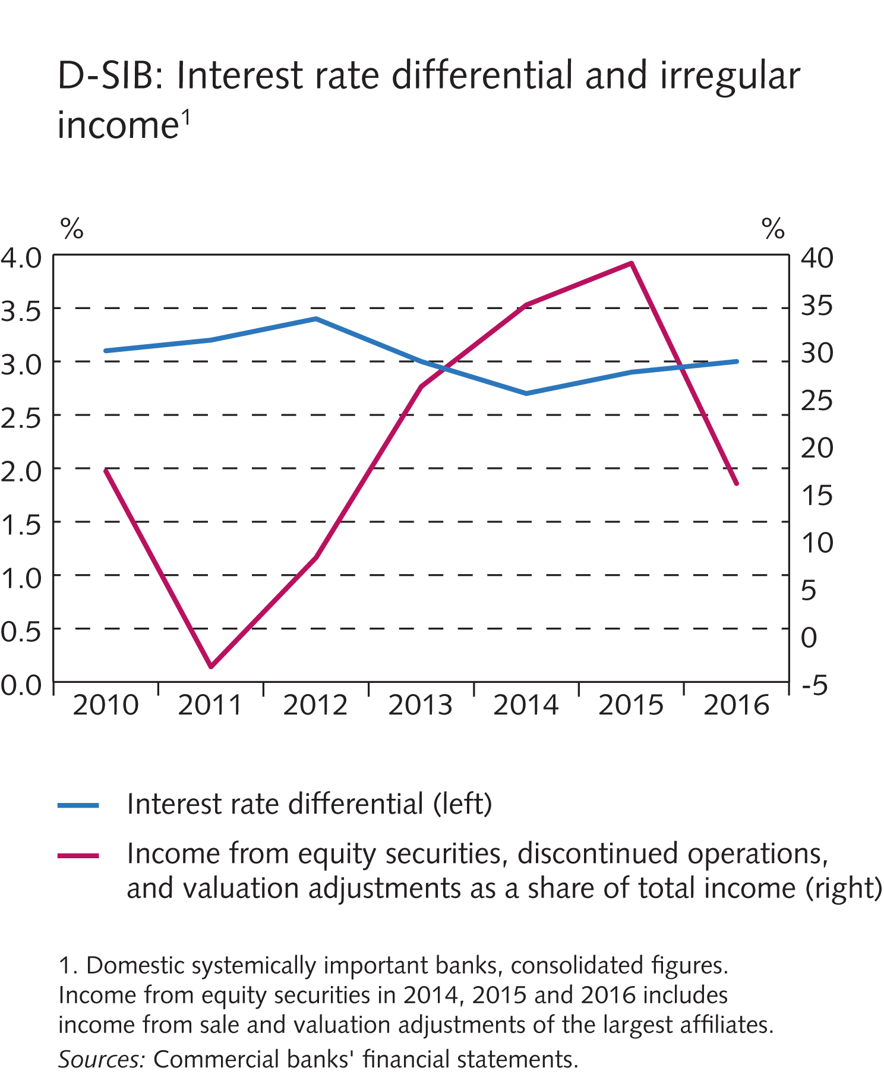
Financial market entities

Slide 43
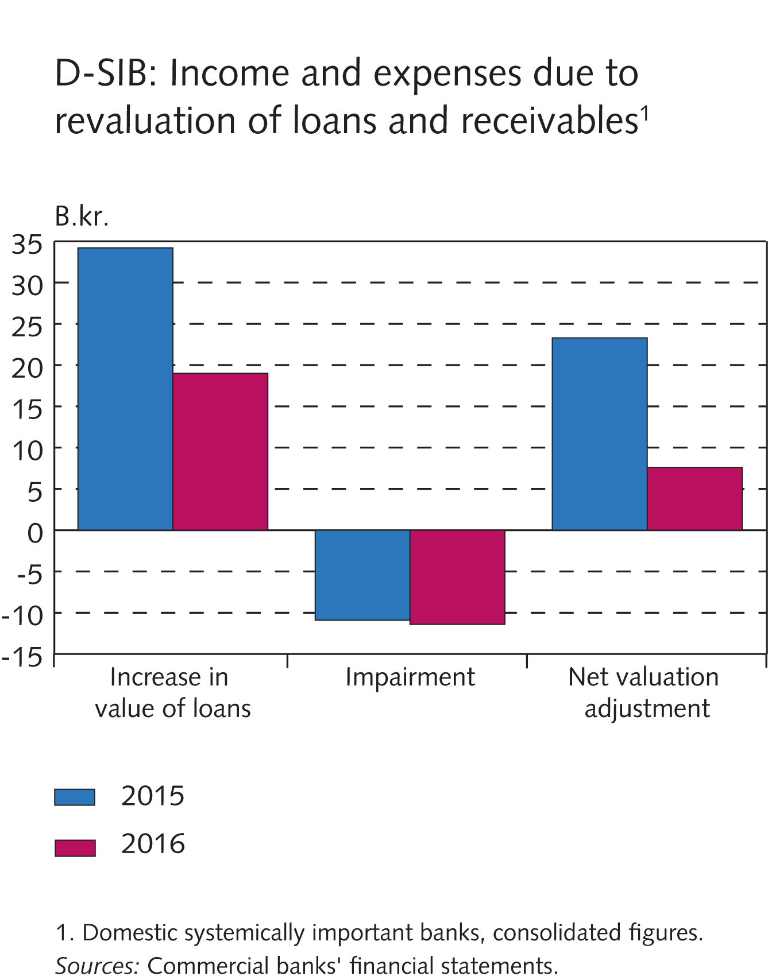
Financial market entities

Slide 44
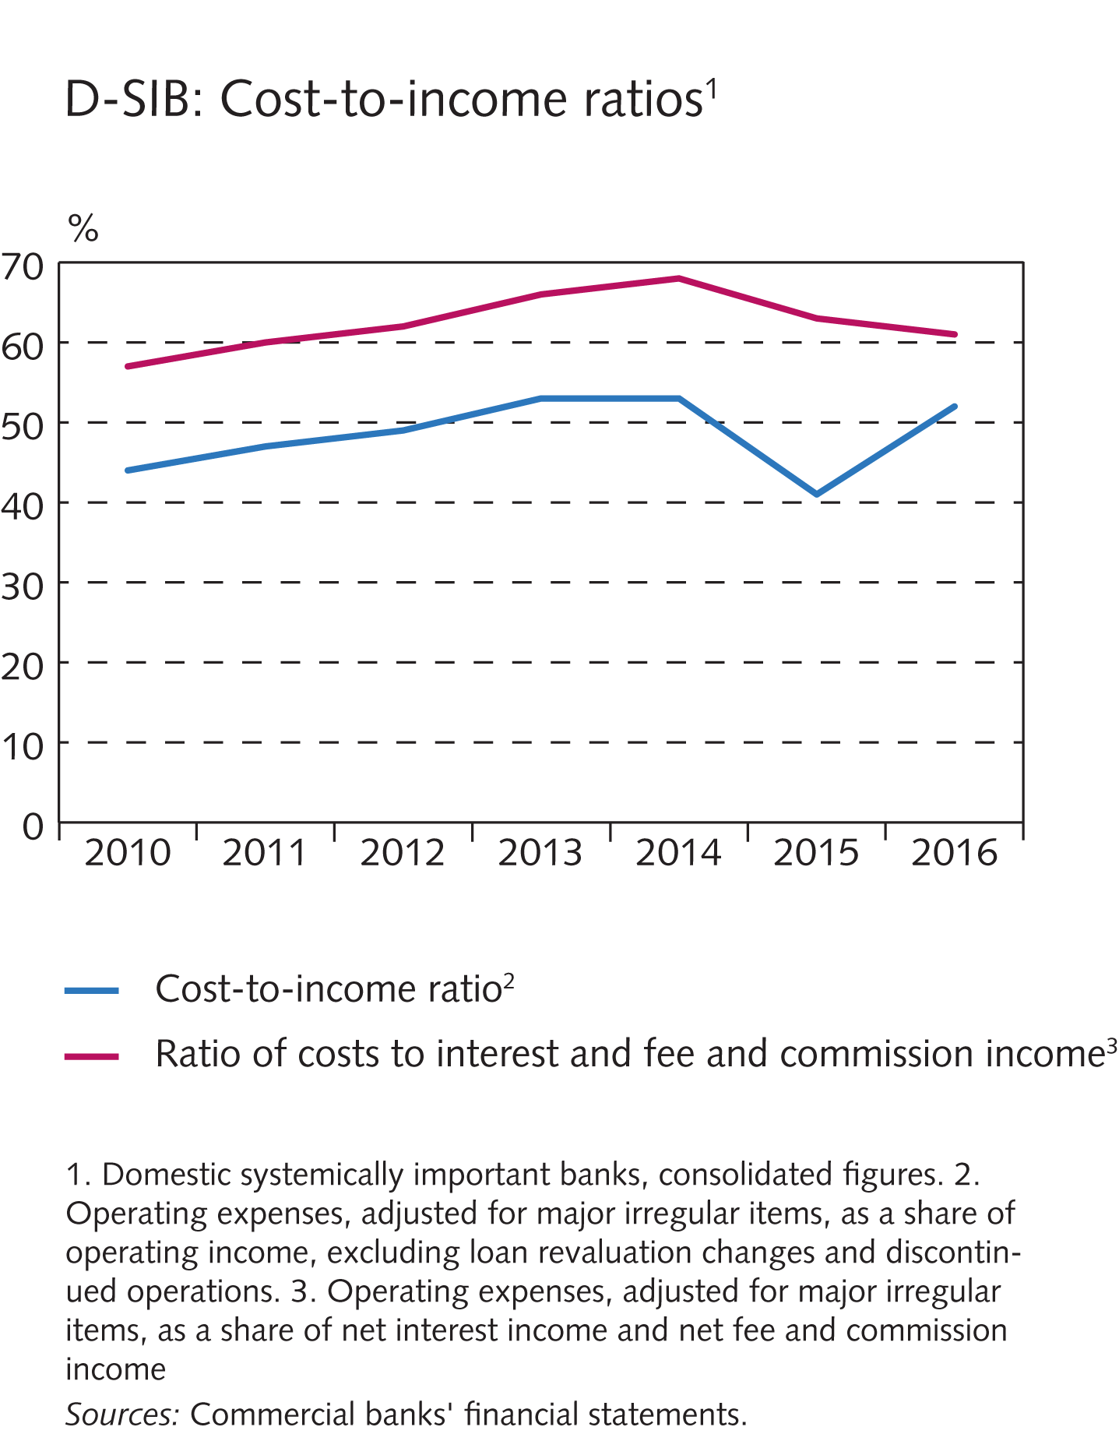
Financial market entities

Slide 45
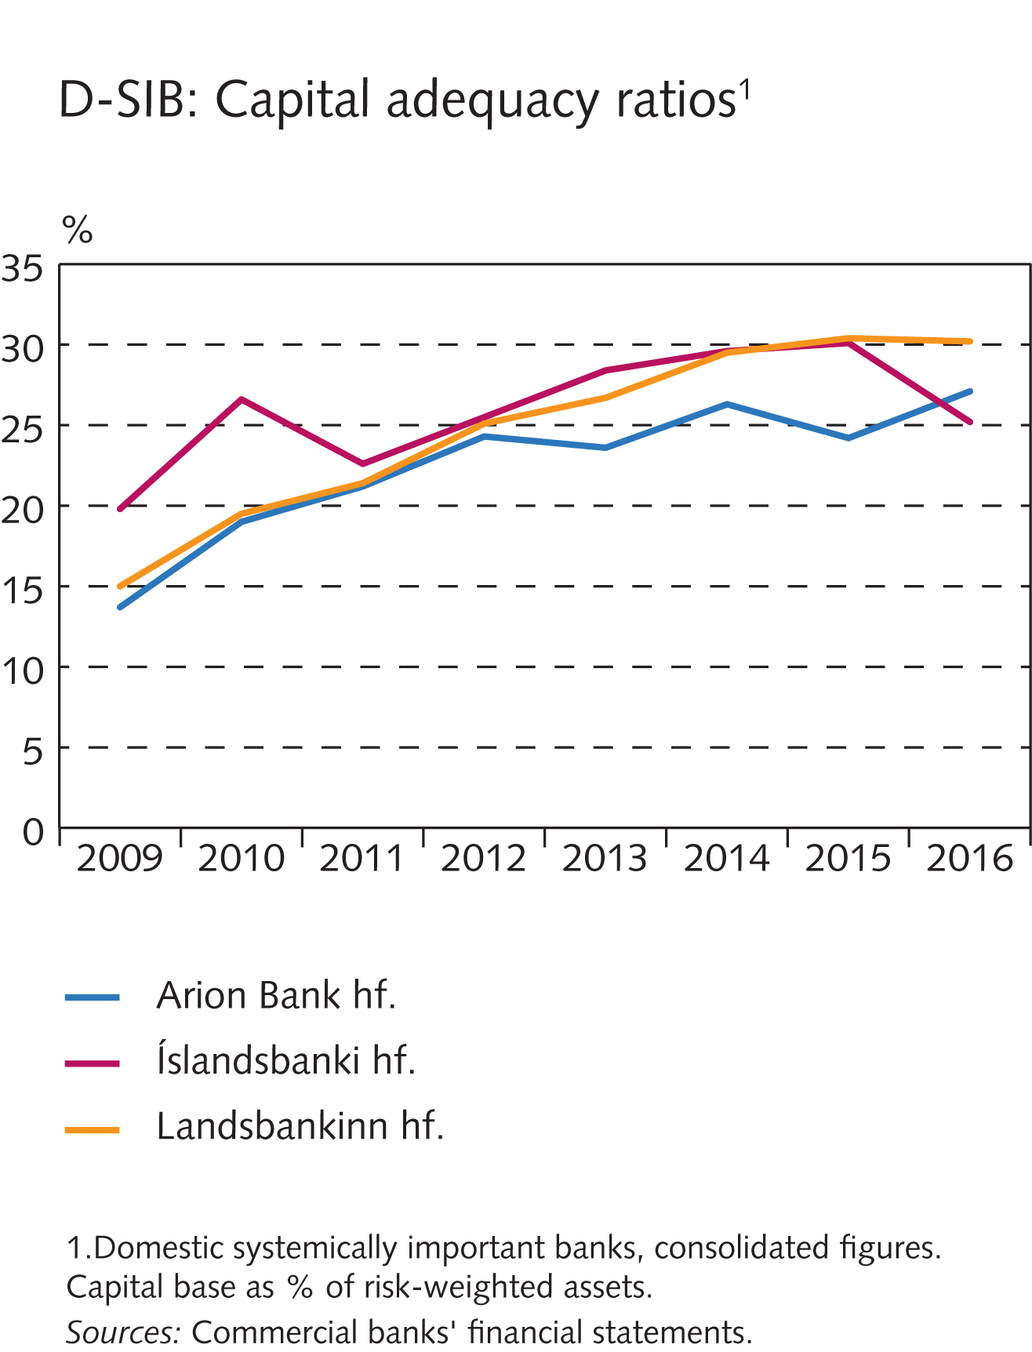
Financial market entities

Slide 46
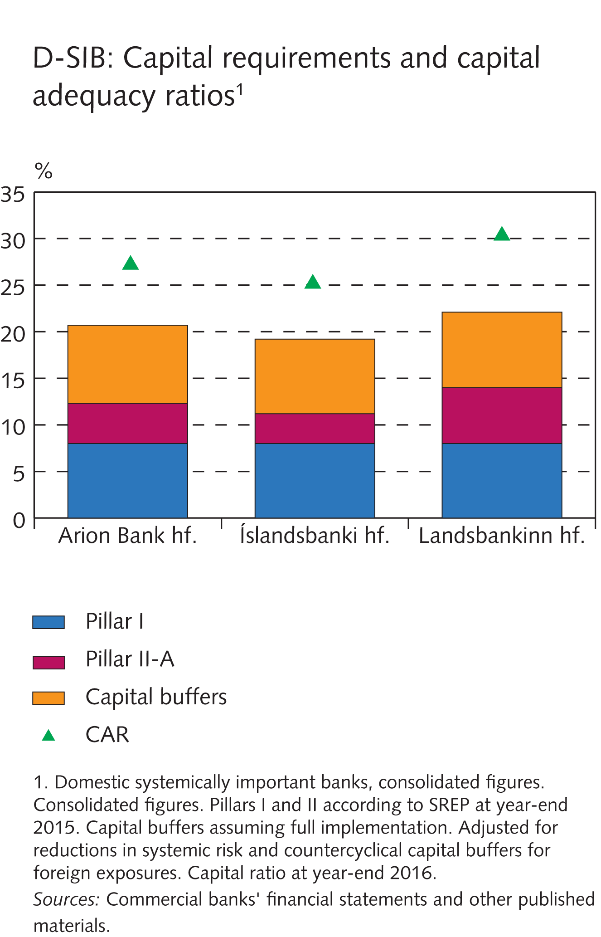
Financial market entities

Slide 47
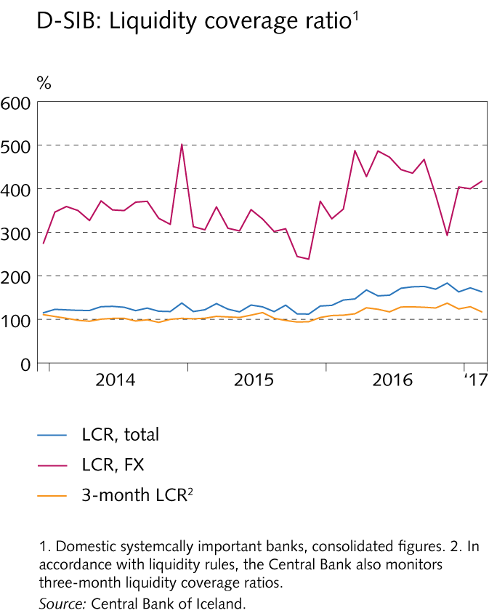
Financial market entities

Slide 48
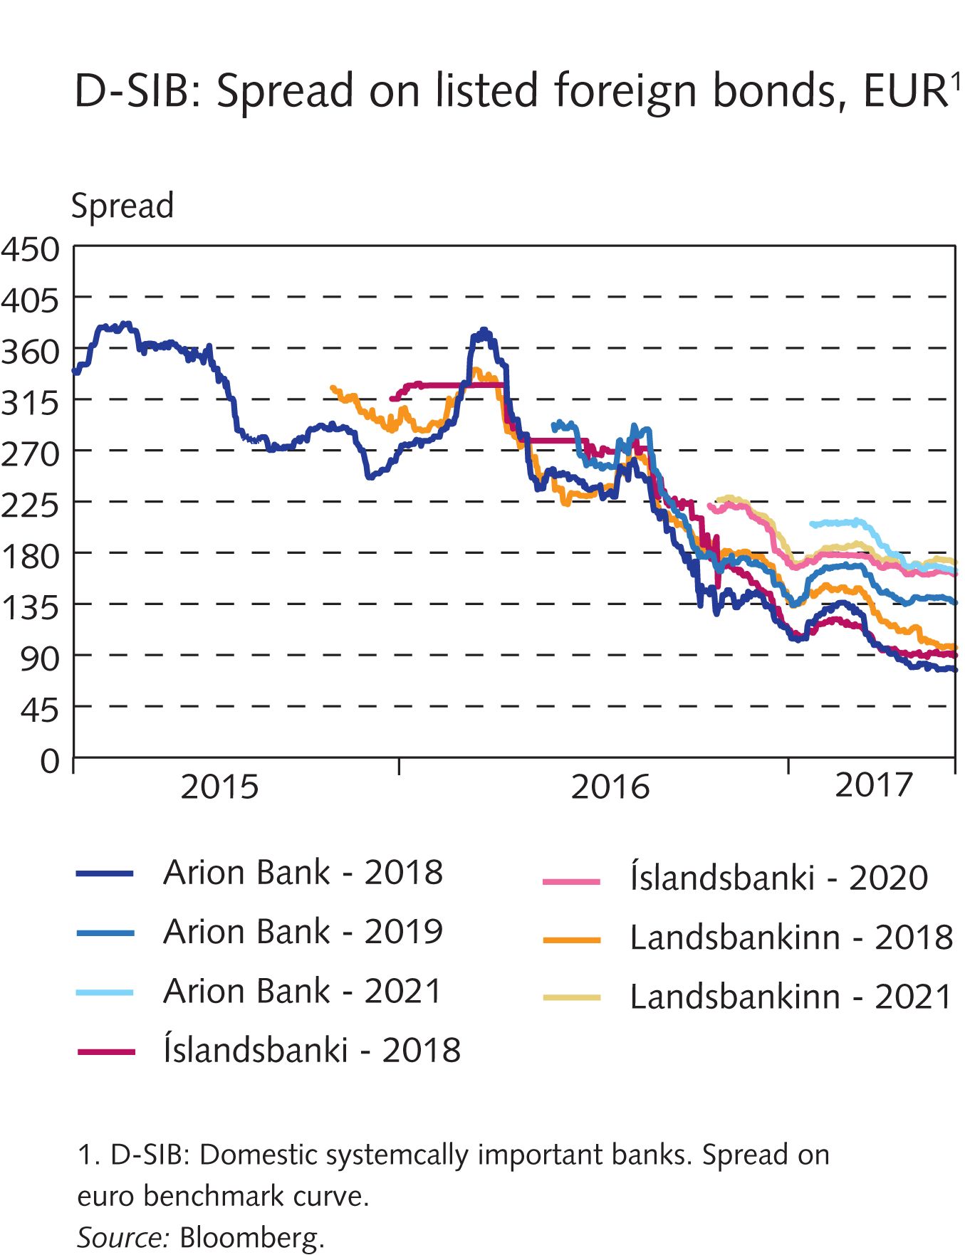
Financial market entities

Slide 49
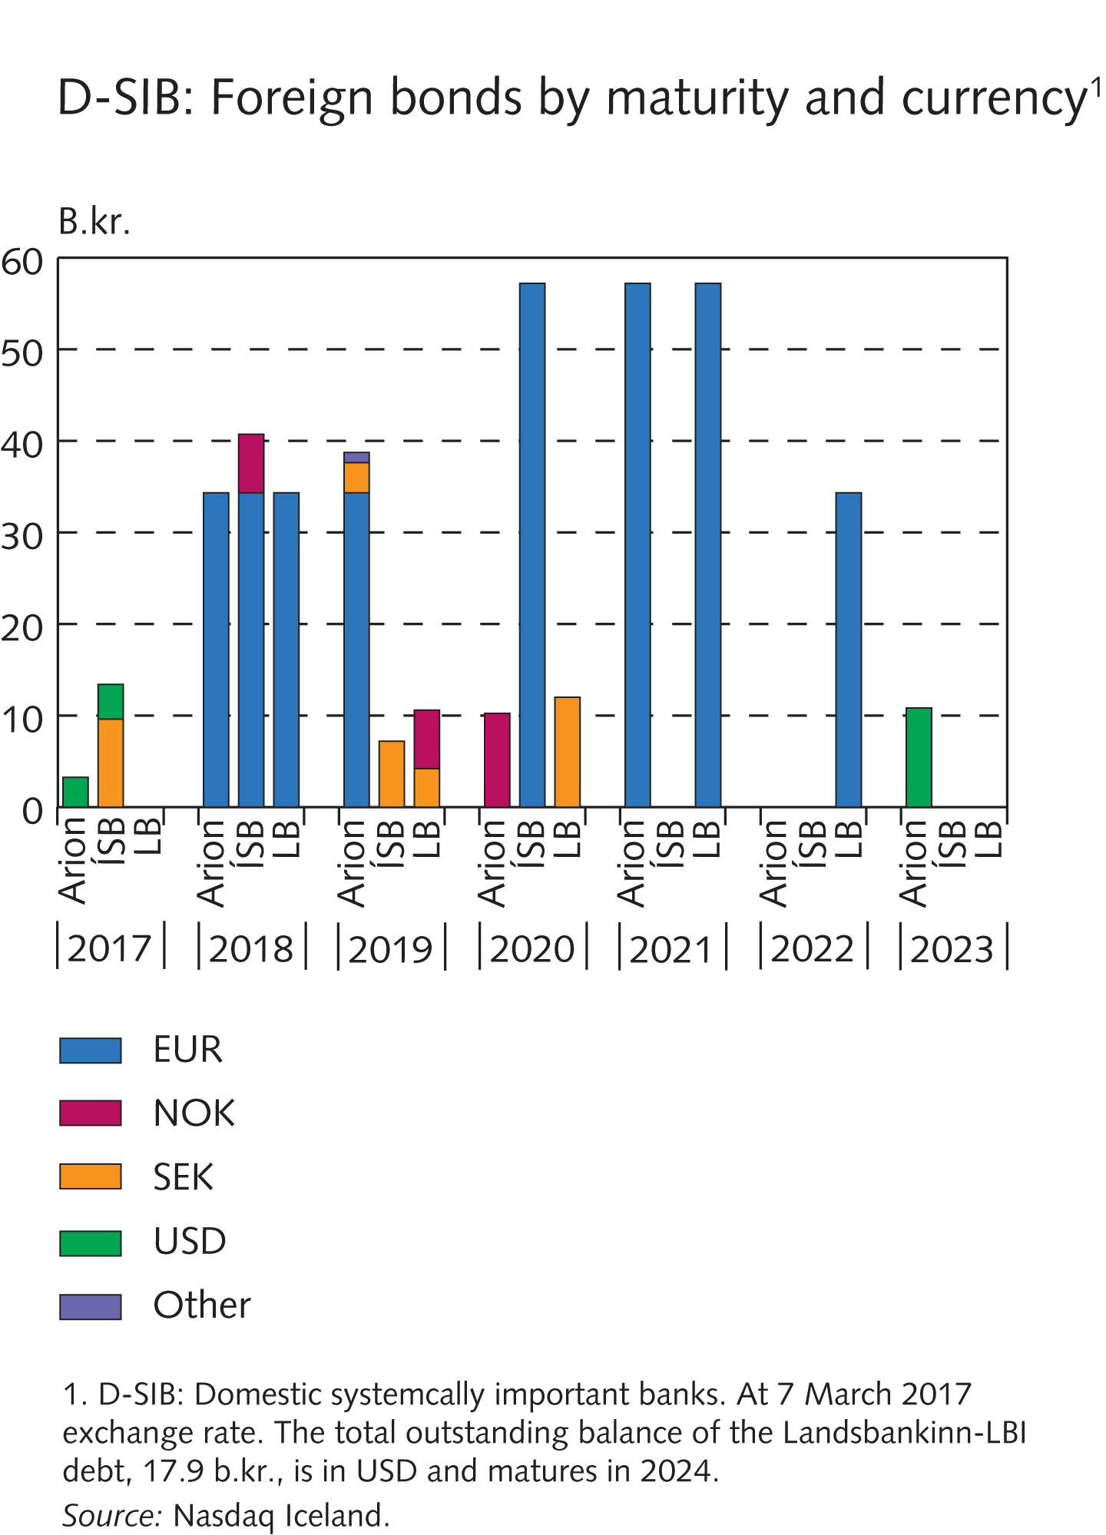
Financial market entities

Slide 50
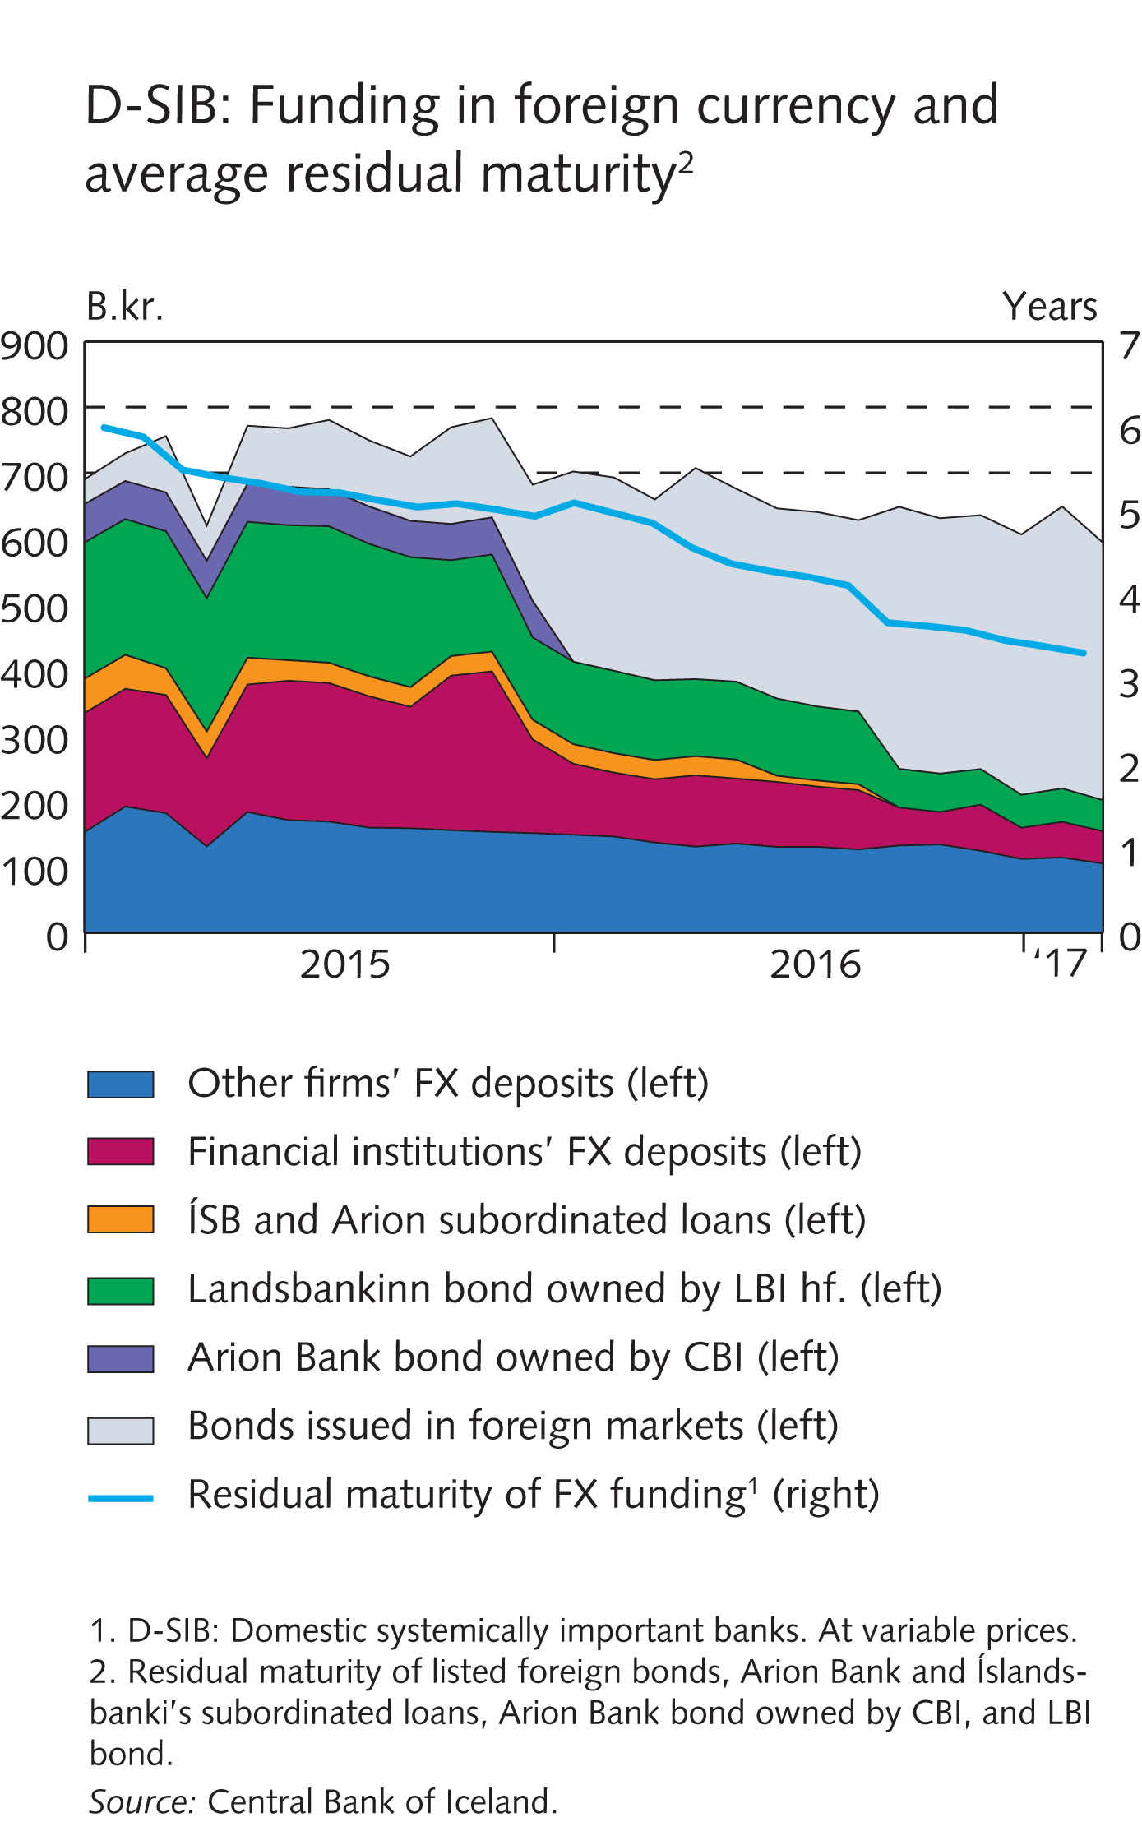
Financial market entities

Slide 51
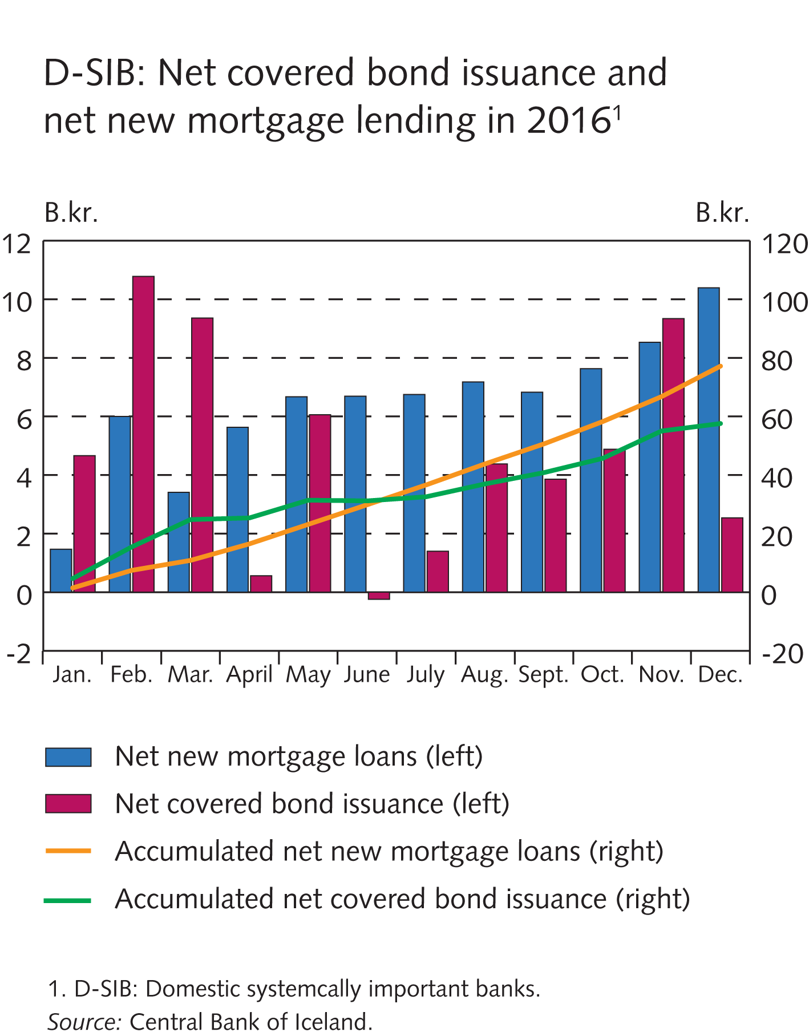
Financial market entities

Slide 52
Box III-1

Slide 53
Box III-2

Slide 54
Box III-2

Slide 55
Financial market entities

Slide 56
Financial market entities

Slide 57
Financial market entities

Slide 58
Financial market entities

Slide 59
Financial market entities

Slide 60
Financial market entities

Slide 61
Financial market entities

Slide 62
Box III-3

Slide 63
Box III-4

Slide 64
Appendix I

Slide 65
Appendix I

Slide 66
Appendix I

Slide 67
Appendix I

Slide 68
Appendix I

Slide 69
Appendix I

Slide 70
Appendix I

Slide 71
Appendix I

Slide 72
Appendix I

Slide 73
Appendix I

Slide 74
Appendix I

Slide 75
Appendix I

Slide 76
Appendix I

Slide 77
Appendix I

Slide 78
Appendix I

Slide 79
Appendix I

Slide 80
Appendix I

Slide 81
Appendix I

Slide 82
Appendix I

Slide 83
Appendix I

Slide 84
Appendix I

Slide 85
Appendix I

Slide 86
Appendix I

Slide 87
Appendix I

Slide 88
Appendix I

Slide 89
Appendix I

Slide 90
Appendix I

Slide 91
Appendix I

Slide 92
Appendix I

Slide 93
Appendix I

Slide 94
Appendix I

Slide 95
Appendix I

Slide 96
Appendix I

Slide 97
Appendix I

Slide 98
Appendix I

Slide 99
Appendix I

Slide 100
Appendix I

Slide 101
Appendix I

Slide 102
Appendix I

Slide 103
Appendix I

Slide 104
Appendix I

Slide 105
Appendix I

Slide 106
Appendix I

Slide 107
Appendix I

Slide 108
Appendix I

Slide 109
Appendix I

Slide 110
Appendix I

Slide 111
Appendix I

Slide 112
Appendix I

Slide 113
Appendix I

Slide 114
Appendix I

Slide 115
Appendix I

Slide 116
Appendix I

Slide 117
Appendix I

Slide 118
Appendix I

Slide 119
Appendix I

Slide 120
Appendix I

Slide 121
Appendix I

Slide 122
Appendix I

Slide 123
Appendix I

Slide 124
Appendix I

Slide 125
Appendix I

Slide 126
Appendix I

Slide 127
Appendix I

Slide 128
Appendix I

Slide 129
Appendix I

Slide 130
Appendix I

Slide 131
Appendix I

Slide 132
Appendix I

Slide 133
Appendix I

Slide 134
Appendix I

Slide 135
Appendix I

Slide 136
Appendix I

Slide 137
Appendix I

Slide 138
Appendix I

Slide 139
Appendix I

Slide 140
Appendix I

Slide 141
Appendix I

Slide 142
Appendix I

Slide 143
Appendix I

Slide 144
Appendix I

Slide 145
Appendix I

